Slide 1


PROSTATE CANCER TRAINING MODULE SECTION I: PROSTATE CANCER OVERVIEW
1 | For internal training purpose only.
Notes:
Welcome to the Prostate Cancer Training Module. This module is divided into 6 sub-sections. The first sub-section will present an overview of the anatomy and physiology of prostate gland. The second sub-section will present the types of prostate cancer including the symptoms and risk factors of prostate cancer. The third sub-section will focus on the epidemiology of prostate cancer. The fourth sub-section will provide information on the diagnostic approaches for screening prostate cancer. The fifth sub-section will present the staging and classification of prostate cancer followed by a final summary sub-section.

Slide 2
Disclaimer
These training slides must be approved by your local medical and regulatory departments in accordance with your country-specific laws and regulations.
These slides are meant for internal training purpose only.
Notes:
Disclaimer
These training slides must be approved by your local medical and regulatory authorities in accordance with your country-specific laws and regulations. These slides are meant for internal training purpose only.

Slide 3
List of Contents
Topics | Slide nos.
Anatomy and physiology of prostate gland | 5-11
Types of prostate cancer Symptoms of prostate cancer Risk factors for prostate cancer | 12-19
Epidemiology of prostate cancer | 20-29
Diagnosis and screening guidelines for prostate cancer | 30-40
Staging and classification of prostate cancer Risk stratification by D’Amico classification | 41-51
Summary | 52-54

Slide 4



Learning Objectives
Provide an overview of prostate cancer as a disease
Explain the epidemiology of prostate cancer
List the risk factors in the development of prostate cancer
Identify the pros and cons of screening for prostate cancer
Describe the various tests and the recommended protocol used for the diagnosis of prostate cancer
Notes:
Learning objectives
At the end of this section, you should be able to:
Provide an overview of prostate cancer as a disease
Describe the epidemiology of prostate cancer
List the risk factors in the development of prostate cancer
Identify the pros and cons of screening for prostate cancer
Describe the various tests and the recommended protocol used for the diagnosis of prostate cancer

Slide 5
Anatomy and Physiology of Prostate Gland

Slide 6
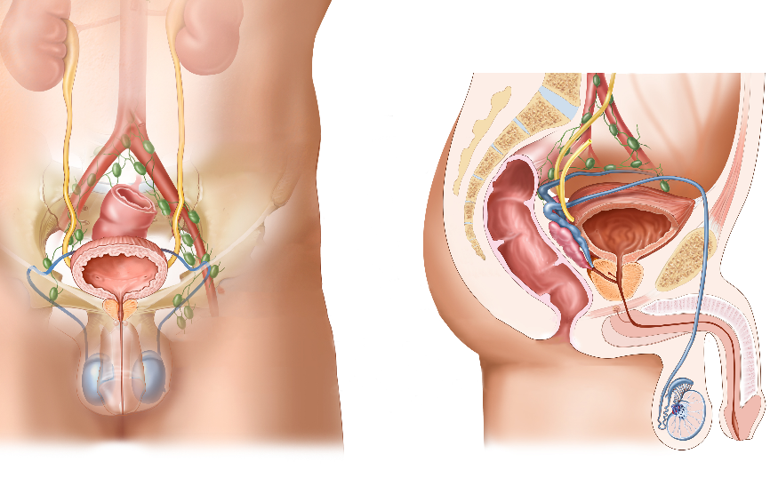
Prostate Gland: Anatomy and Physiology
1/6
Anatomy of the male reproductive and urinary systems³
The prostate gland is located in the pelvis, just below the bladder and in front of the rectum.^{1,2}
The seminal vesicles located behind the prostate, along with the prostate gland, produce the fluid for the semen.¹
The urethra, which carries urine and semen out through the penis, passes through the prostate.¹
Ureter
Lymph node
Rectum
Seminal vesicle
Bladder
Ejaculatory duct
Prostate gland
Vas deferens
Urethra
Penis
Testis
Adapted from Prostate Cancer Treatment, 2016³
http://www.cancer.org/acs/groups/cid/documents/webcontent/003134-pdf.pdf. Accessed April 4, 2016.
Scher HI, et al. Harrison’s Principles of Internal Medicine. Vol. 1. 19th ed. New York, NY: McGraw-Hill Education; 2015:579-587.
http://www.cancer.gov/types/prostate/patient/prostate-treatment-pdq. Accessed May 12, 2016.
Notes:
Anatomy and physiology of prostate gland
To understand the disease, we must first familiarise ourselves with the anatomy of the prostate gland.
The prostate gland is located in the pelvis, just below the bladder and in front of the rectum.^{1,2} /p1/para3, /p579/col2/para4
The seminal vesicles located behind the prostate, along with the prostate gland, produce the fluid for the semen.¹ The urethra, which carries urine and semen out through the penis, passes through the prostate.¹ /p1/para3-4
Let us now proceed to understand where and how cancer is initiated.
References:
Prostate cancer. American Cancer Society Web site. http://www.cancer.org/acs/groups/cid/documents/webcontent/003134-pdf.pdf. Accessed April 4, 2016.
Scher HI, Eastham JA. Benign and malignant diseases of the prostate. In: Kasper DL, Fauci AS, Hauser SL, Longo DL, Jameson JL, Loscalzo J, eds. Harrison’s Principles of Internal Medicine. Vol. 1. 19th ed. New York, NY: McGraw-Hill Education; 2015:579-587.

Slide 7
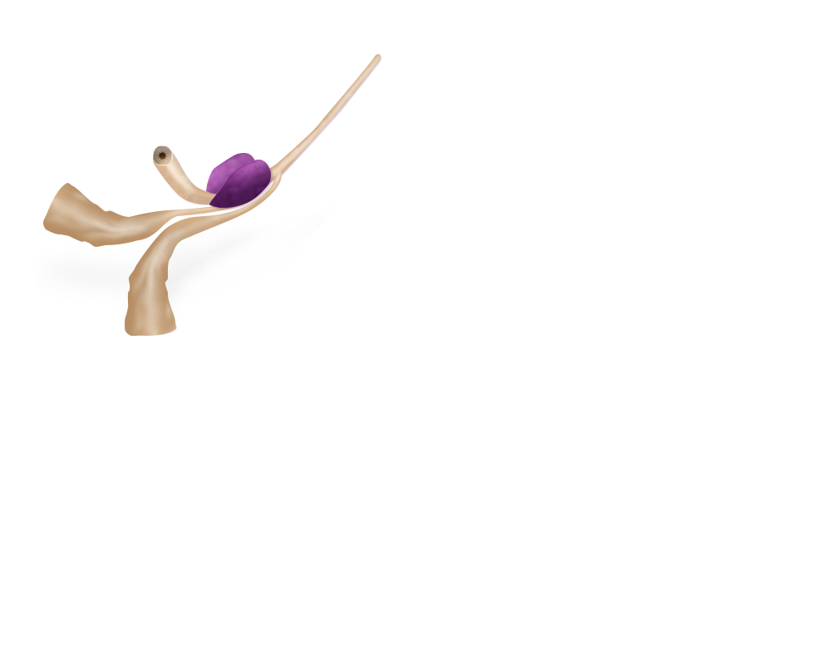
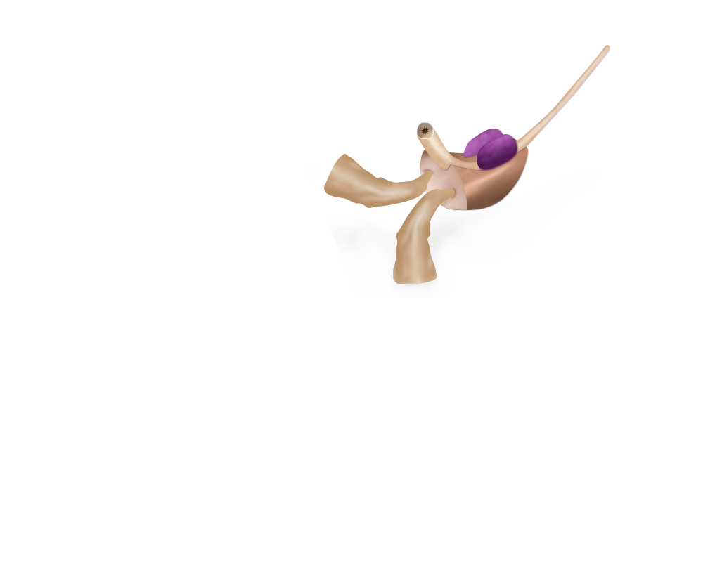
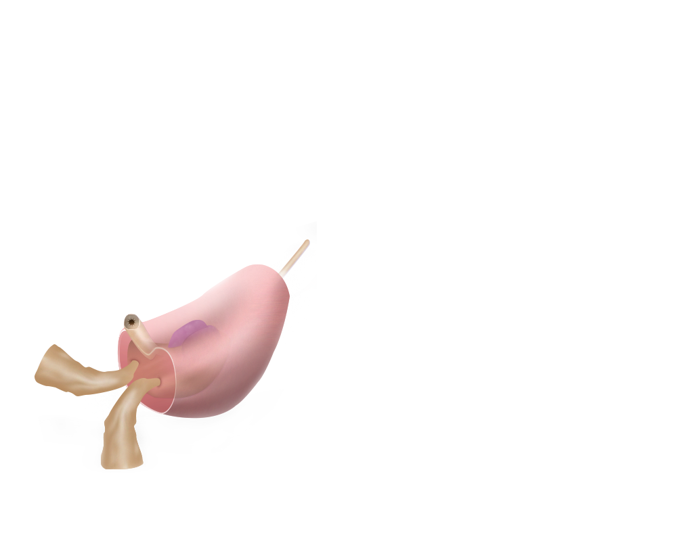
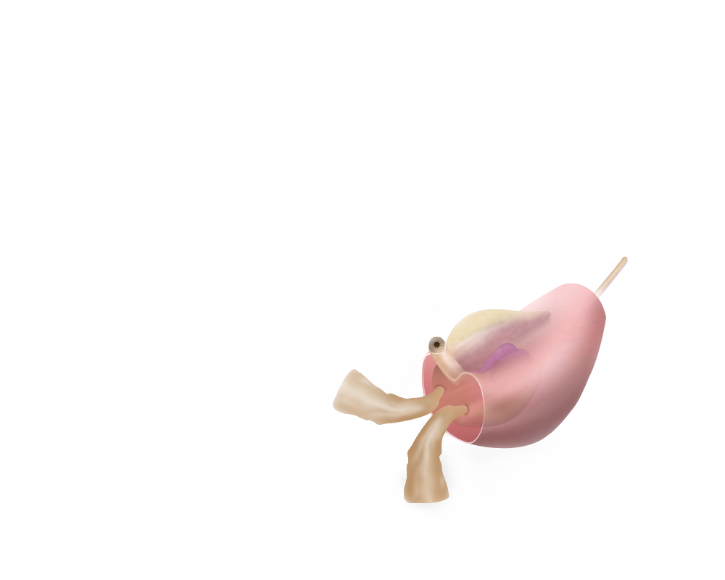
Prostate Gland: Anatomy and Physiology (cont.)
2/6
The 4 major zones in the normal prostate are peripheral zone, central zone, transition zone and anterior fibromuscular stroma.¹
Malignant and nonmalignant changes in the prostate increase with age.²
Cause proportional increase in prostate size.³
Increase in prostate size in the elderly (>55 years) occurs due to increase in the number of nonmalignant cells in the transition zone.²
Nonmalignant changes described as benign prostatic hyperplasia (BPH) typically develop in the transition zone.⁴
Cancer cells typically develop in the peripheral zone.²
Zonal anatomy of the human prostate¹
Transition zone
Central zone
Peripheral zone
Anterior fibromuscular stroma
Adapted from Logothetis, 2010¹
Logothetis CJ, et al. Holland Frei Cancer Medicine. 10th ed. Philadelphia, PA: AACR Publications; 2010:1228-1254.
Scher HI, et al. Harrison’s Principles of Internal Medicine. Vol. 1. 19th ed. New York, NY: McGraw-Hill Education; 2015:579-587.
http://www.cancer.org/acs/groups/cid/documents/webcontent/003134-pdf.pdf. Accessed April 4, 2016.
Diaw L, et al. Gene Regul Syst Bio. 2007;1:313-325.
Notes:
Anatomy and physiology of prostate gland (cont.)
There are 4 major zones in the normal prostate: peripheral zone, central zone, transition zone and anterior fibromuscular stroma.¹ /p1229/Fig94-2
Malignant and nonmalignant changes in the prostate increase with age.² /p579/col2/para3 Increase in age translates to changes in prostate size.³ /p1/para3
Increase in prostate size in the elderly (>55 years) occurs due to increase in the number of nonmalignant cells in the transition zone of the prostate, which is the area of the prostate surrounding the urethra.² /p579/col2/para3 Nonmalignant changes described as benign prostatic hyperplasia (BPH) typically develop in this transition zone and are responsible for the increased prostate size.⁴ /p314/col1/para2
Most prostate cancers typically develop in the peripheral zone.² /p580/col1/para2
References:
Logothetis CJ, Kim J, Davis J, et al. Neoplasms of the prostate. In: Hong WK, Bast RC, Hait WN, et al, eds. Holland Frei Cancer Medicine. 10th ed. Philadelphia, PA: AACR Publications; 2010:1228-1254.
Scher HI, Eastham JA. Benign and malignant diseases of the prostate. In: Kasper DL, Fauci AS, Hauser SL, Longo DL, Jameson JL, Loscalzo J, eds. Harrison’s Principles of Internal Medicine. Vol. 1. 19th ed. New York, NY: McGraw-Hill Education; 2015:579-587.
Prostate cancer. American Cancer Society Web site. http://www.cancer.org/acs/groups/cid/documents/webcontent/003134-pdf.pdf. Accessed April 4, 2016.
Diaw L, Woodson K, Gillespie JW. Prostate cancer epigenetics: a review on gene regulation. Gene Regul Syst Bio. 2007;1:313-325. http://www.ncbi.nlm.nih.gov/pmc/articles/PMC2759139/. Accessed April 8, 2016.

Slide 8
Prostate Gland: Anatomy and Physiology (cont.)
3/6
Prostate-specific antigen (PSA) and prostatic acid phosphatase (PAP) are produced by the epithelial cells of the prostate.¹
These epithelial cells along with stromal cells also express androgen receptors (ARs) and depend on androgens for their growth.¹
Testosterone (T) is the major androgen responsible for this growth and is broken down to dihydrotestosterone (DHT) by the enzyme 5-alpha reductase in the prostate.¹
Scher HI, et al. Harrison’s Principles of Internal Medicine. Vol. 1. 19th ed. New York, NY: McGraw-Hill Education; 2015:579-587.
Notes:
Anatomy and physiology of prostate gland (cont.)
The epithelial cells of the prostate produce prostate-specific antigen (PSA) and prostatic acid phosphatase (PAP).¹ /p580/col1/para1 These epithelial cells along with stromal cells also express androgen receptors (ARs) and rely on androgens, such as testosterone (T) and dihydrotestosterone (DHT), for their growth.¹ /p580/col1/para1 Testosterone is broken down to its more active metabolite, DHT, by the enzyme 5-alpha reductase.¹ /p580/col1/para1
Let’s move on to the biochemical changes that drive prostate growth.
Reference:
Scher HI, Eastham JA. Benign and malignant diseases of the prostate. In: Kasper DL, Fauci AS, Hauser SL, Longo DL, Jameson JL, Loscalzo J, eds. Harrison’s Principles of Internal Medicine. Vol. 1. 19th ed. New York, NY: McGraw-Hill Education; 2015:579-587.

Slide 9
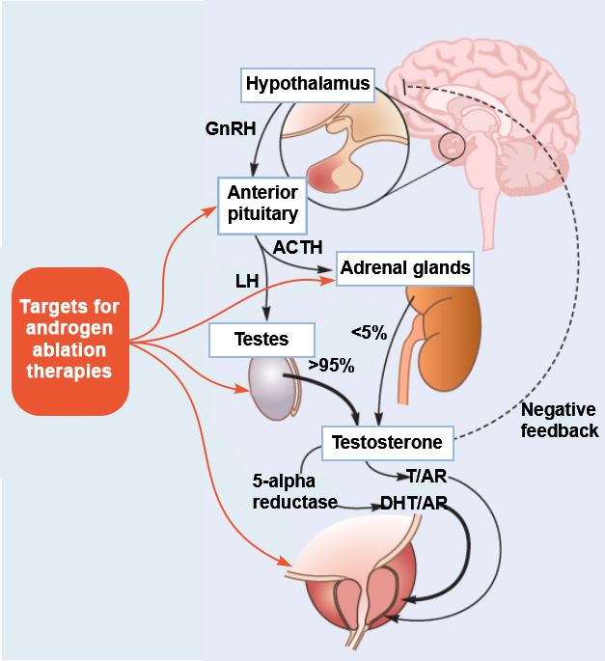
Androgen Regulation of Prostate
4/6
Hypothalamus-pituitary-gonadal axis^{1,2}
Gonadotropin-releasing hormone (GnRH)
Luteinising hormone (LH)
Adrenocorticotropic hormone (ACTH)
Testosterone (T)
5-alpha reductase
Dihydrotestosterone (DHT)
Binds
Androgen receptor (AR)
Adapted from Lamb, 2013¹; Denmeade, 2010²
Lamb AD, et al. Trends Urol Mens Health. 2013;4(3):26-30.
Denmeade SR. Holland-Frei Cancer Medicine. 8th ed. Philadelphia, PA: AACR Publications; 2010:750-758.
Notes:
Androgen regulation of prostate
Androgens, including T and its more active metabolite DHT, regulate the proliferation and death of cells in a normal prostate. The organs involved in the regulation of androgen production include the hypothalamus, pituitary, testes and adrenal glands.^{1,2} /p26/Fig1, /p27/col1/para2, /p750/col3/para2, /p751/col1/para1
At the very top of the hypothalamus-pituitary axis is the hypothalamus that releases gonadotropin-releasing hormone (GnRH) or luteinising hormone-releasing hormone (LHRH), which then reaches the anterior pituitary, where it stimulates the release of luteinising hormone (LH) and adrenocorticotrophic hormone (ACTH). These in turn act on the testes and adrenal glands, respectively. While the testes produce 95% of the circulating T on stimulation by LH, the adrenal glands produce androstenedione and dehydroepiandrosterone, both precursors to T, on stimulation by ACTH. Testosterone is converted to DHT by the enzyme 5-alpha reductase. Both T and DHT can act as ligands to the AR. Feedback loops are responsible for modulating these secretions from the pituitary and the hypothalamus.^{1,2} /p26/Fig1, /p27/col1/para2, /p750/col3/para2, /p751/col1/para1
In prostate cancer, androgen ablation therapies can be used to deprive androgen-dependent cancer cells of androgen stimulation. This can be achieved by surgical removal of testes or suppression of LH release from pituitary or inhibition of androgenic synthesis from testes and adrenals or inhibition of androgen action at the level of androgen-dependent prostatic cancer cells.² /p751/col1/para2
Let us pause for a moment here to reflect on what we have learnt so far.
References:
Lamb AD, Neal DE. Role of the androgen receptor in prostate cancer. Trends Urol Mens Health. 2013;4(3):26-30. doi:10.1002/tre.331.
Denmeade SR. Androgen deprivation strategies in the treatment of advanced prostate cancer. In: Hong WK, Bast RC Jr, Hait WN, et al, eds. Holland-Frei Cancer Medicine. 8th ed. Philadelphia, PA: AACR Publications; 2010:750-758.

Slide 10


Knowledge Check (1)
5/6
Which of the following is the most common site for prostate cancer?
Peripheral zone
Central zone
Transition zone
Anterior fibromuscular stroma
Peripheral zone
Notes:
Knowledge check (1)
Which of the following is the most common site for prostate cancer?
Peripheral zone
Central zone
Transition zone
Anterior fibromuscular stroma
Answer: 1. The peripheral zone is the most common site for the development of prostate cancer.

Slide 11
Knowledge Check (2)
6/6
Which of the following hormones are capable of binding to the androgen receptor?
LH
Testosterone
5-alpha reductase
DHT
Testosterone
DHT
DHT, dihydrotestosterone; LH, luteinising hormone.
Notes:
Knowledge check (2)
Which of the following hormones are capable of binding to the androgen receptor?
LH
Testosterone
5-alpha reductase
DHT
Answer: 2 and 4. Both testosterone and dihydrotestosterone can act as ligands to the androgen receptor.
DHT, dihydrotestosterone; LH, luteinising hormone.

Slide 12
Types of Prostate Cancer

Slide 13
Types of Prostate Cancer
1/7
A majority of prostate cancers are adenocarcinomas (95%)^{1,2}
Other types of prostate cancer are rare and include¹:
Sarcomas
Small cell carcinomas
Neuroendocrine tumours
Transitional cell carcinomas
Most prostate cancers grow slowly¹
Possible precancerous conditions include:
Prostatic intraepithelial neoplasia (PIN)¹
Low-grade PIN: link to developing cancer unclear
High-grade PIN: 20% chance of cancer in other areas of prostate
Proliferative inflammatory atrophy (PIA)¹
May lead to high-grade PIN or prostate cancer
http://www.cancer.org/acs/groups/cid/documents/webcontent/003134-pdf.pdf. Accessed April 4, 2016.
http://www.ncbi.nlm.nih.gov/books/NBK66036/. Accessed April 9, 2016.
Notes:
Types of prostate cancer
Around 95% of prostate cancers are adenocarcinomas.^{1,2} /p2/para1, /p3/para3 Other types of prostate cancer include sarcomas, small cell carcinomas, neuroendocrine tumours and transitional cell carcinomas. These types are rare and most patients with prostate cancer present with adenocarcinomas.¹ /p2/para2-3
While there are some aggressive cases, most prostate cancers tend to grow slowly.¹ /p2/para4 Possible precancerous conditions include prostatic intraepithelial neoplasia (PIN) and proliferative inflammatory atrophy (PIA).¹ /p2/para5-8, /p3/para1-2 PINs are further classified as low grade (grade 1) and high grade (grades 2 and 3) and the high-grade form can be a precursor to adenocarcinoma.² /p3/para3
Let us move on to the next segment where we begin by studying the symptoms of prostate cancer.
References:
Prostate cancer. American Cancer Society Web site. http://www.cancer.org/acs/groups/cid/documents/webcontent/003134-pdf.pdf. Accessed April 4, 2016.
PDQ Adult Treatment Editorial Board. Prostate cancer treatment (PDQ®): Health professional version. In: PDQ Cancer Information Summaries. Bethesda (MD): National Cancer Institute (US); 2002. http://www.ncbi.nlm.nih.gov/books/NBK66036/. Accessed April 9, 2016.

Slide 14
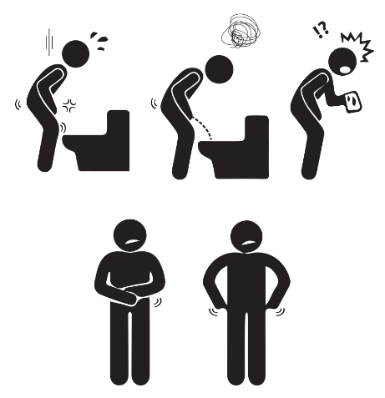
Symptoms of Prostate Cancer
2/7
Early prostate cancer typically has no symptoms, and it may be detected during a routine examination^{1,2}:
PSA blood test
Digital rectum exam (DRE)
Advanced prostate cancer symptoms include¹:
Weak or interrupted urine flow
Frequent urination
Inability to urinate
Pain or burning during urination
Blood in the urine
Symptoms of prostate cancer^{1,3}
Difficulty urinating
Weak urine flow
Blood in urine
Adapted from Cancer Facts and Figures, 2015¹; Advanced Prostate Cancer, 2016³
http://www.cancer.org/acs/groups/content/@editorial/documents/document/acspc-044552.pdf. Accessed April 6, 2016.
http://uroweb.org/wp-content/uploads/09-Prostate-Cancer_LR.pdf. Accessed April 8, 2016.
http://www.cancer.org.au/content/pdf/HealthProfessionals/ClinicalGuidelines/Advanced_Prostate_Cancer_Guide_2009_BOOKMARKS.pdf. Accessed May 5, 2016.
Notes:
Symptoms of prostate cancer
Patients with prostate cancer may not experience any symptoms for many years. They are often first diagnosed by an elevated PSA level or during a routine digital rectal exam (DRE).^{1,2} /p20/col2/para2, p20/para8 In more advanced cases, the tumour may enlarge and press on the urethra, which can lead to weak or interrupted urine flow, frequent urination, inability to urinate, pain or burning during urination and blood in the urine.¹ /p20/col2/para2
References:
Cancer facts and figures 2015. American Cancer Society Web site. http://www.cancer.org/acs/groups/content/@editorial/documents/document/acspc-044552.pdf. Accessed April 6, 2016.
Mottet N, Bellmunt J, Briers E, et al. Guidelines on prostate cancer. European Association of Urology Web site. http://uroweb.org/wp-content/uploads/09-Prostate-Cancer_LR.pdf. Accessed April 8, 2016.

Slide 15
Symptoms of Prostate Cancer (cont.)
3/7
Metastasised prostate cancer symptoms include^{1,2}:
Pain in the hips, ribs, spine, etc.
Weakness or numbness in the legs or feet
Unexplained constipation, urine or bowel incontinence
Diagnosis of prostate cancer is based on³:
DRE or PSA levels
Histopathological verification by prostate biopsy
Symptoms of prostate cancer^{1,2}
Pelvic discomfort
Bone pain
and stiffness
Adapted from Cancer Facts and Figures, 2015¹; Advanced Prostate Cancer, 2016³
http://www.cancer.org/acs/groups/content/@editorial/documents/document/acspc-044552.pdf. Accessed April 6, 2016.
http://www.cancer.org.au/content/pdf/HealthProfessionals/ClinicalGuidelines/Advanced_Prostate_Cancer_Guide_2009_BOOKMARKS.pdf. Accessed May 5, 2016.
http://uroweb.org/wp-content/uploads/09-Prostate-Cancer_LR.pdf. Accessed April 8, 2016.
Notes:
Symptoms of prostate cancer (cont.)
Prostate cancer can spread locally into the surrounding tissue or the nearby lymph nodes and can metastasise to other areas of the body.¹ /p20/col2/para2 Prostate cancer usually metastasises first to the lower spine or the pelvic bones causing back, pelvic or hip pain.¹ /p20/col2/para2 Other symptoms associated with metastatic prostate cancer can be unexplained constipation, urine or bowel incontinence.² /p81/col1/para3
Diagnosis of prostate cancer begins with DRE or measurement of serum PSA levels. Suspect results are followed up with a core biopsy of the prostate and histopathologically verified for the presence of adenocarcinoma.³ /p20/para8
References:
Cancer facts and figures 2015. American Cancer Society Web site. http://www.cancer.org/acs/groups/content/@editorial/documents/document/acspc-044552.pdf. Accessed April 6, 2016.
Advanced prostate cancer: a guide for men and their families. Cancer Council Australia Web site. http://www.cancer.org.au/content/pdf/HealthProfessionals/ClinicalGuidelines/Advanced_Prostate_Cancer_Guide_2009_BOOKMARKS.pdf. Accessed May 5, 2016.
Mottet N, Bellmunt J, Briers E, et al. Guidelines on prostate cancer. European Association of Urology Web site. http://uroweb.org/wp-content/uploads/09-Prostate-Cancer_LR.pdf. Accessed April 8, 2016.

Slide 16

Risk Factors for Prostate Cancer
4/7
Risk factors for prostate cancer^{1,2}
Established risk factors | Possible risk factors (not backed by statistically significant data)
Age | Geography | Chemical exposure
Ethnicity/race | Diet | Sexually transmitted infections
 |  | Inflammation
 | Smoking | Vasectomy
Heredity
Obesity
Adapted from Mottet, 2015¹; Prostate Cancer, 2016²
Chances of acquiring prostate cancer increase with age²:
1 in 304 from birth to 49 years of age³
1 in 44 from 50 to 59 years of age³
1 in 16 from 60 to 69 years of age³
1 in 9 after 70 years of age³
http://uroweb.org/wp-content/uploads/09-Prostate-Cancer_LR.pdf. Accessed April 8, 2016.
http://www.cancer.org/acs/groups/cid/documents/webcontent/003134-pdf.pdf. Accessed April 4, 2016.
http://www.cancer.org/acs/groups/content/@editorial/documents/document/acspc-044552.pdf. Accessed April 6, 2016.
Notes:
Risk factors for prostate cancer
Established risk factors for prostate cancer include advancing age, ethnicity/race and heredity.¹ /p16/para6
The chances of acquiring prostate cancer increase with age. About 6 in 10 cases are detected in men aged over 65 years.² /p4/para4 Based on data collected by the National Cancer Institute from 2009 to 2011, the chances of acquiring invasive prostate cancer are 1 in 304 from birth to 49 years of age, 1 in 44 from 50 to 59 years of age, 1 in 16 from 60 to 69 years of age, and 1 in 9 after 70 years of age.³ /p14/Table
Prostate cancer is more common in African-American men (214.5 per 100,000 men) than in white men (130.4 in 100,000 men).⁴ /p4/para2 Mortality in African men is double than that seen in white men.² /p4/para5 Asian Americans and Hispanic or Latino men have lower incidence rates of prostate cancer, but the reasons for this are unclear.² /p4/para2
Heredity plays a role in the development of prostate cancer. The risk is 2-fold if a first-line relative has prostate cancer and 5- to 11-fold if two or more first-line relatives have prostate cancer. Those patients who have three or more relatives with prostate cancer typically have an onset 6-7 years earlier than nonhereditary cases.¹ /p16/para4
Risk factors with a less clear role in the development of prostate cancer include geography, diet, obesity, smoking, chemical exposure, sexually transmitted infections, inflammation and vasectomy.² /p5/para5-7, /p6/para1-8, /p7/para1
There is a lack of consensus among studies regarding the association of higher plasma insulin-like growth factor levels or the presence of metabolic syndrome with a higher prostate cancer risk.⁴ /p4/para2
The incidence of clinical prostate cancer is higher in the US and Europe and lower in Asia. Japanese men increase their risk of developing prostate cancer if they move to Hawaii and mainland US. This suggests the role of exogenous factors such as diet, sexual behaviour, radiation and inflammation.¹ /p16/para8 Currently, there are no data supporting the role of these factors. Studies so far have not proven the beneficial role of vitamin E, selenium or lycopene consumption on the risk of developing of prostate cancer. Similarly, there is insufficient evidence to recommend a specific dietary plan for the prevention of prostate cancer.¹ /p17/para2-4
It is important to remember that various factors may influence a man’s risk of getting prostate cancer. The 3 established risk factors include advancing age, ethnicity/race and heredity, while other possible risk factors include geography, diet, obesity, smoking, chemical exposure, sexually transmitted infections, inflammation and vasectomy.
References:
Mottet N, Bellmunt J, Briers E, et al. Guidelines on prostate cancer. European Association of Urology Web site. http://uroweb.org/wp-content/uploads/09-Prostate-Cancer_LR.pdf. Accessed April 8, 2016.
Prostate cancer. American Cancer Society Web site. http://www.cancer.org/acs/groups/cid/documents/webcontent/003134-pdf.pdf. Accessed April 4, 2016.
Cancer facts and figures 2015. American Cancer Society Web site. http://www.cancer.org/acs/groups/content/@editorial/documents/document/acspc-044552.pdf. Accessed April 6, 2016.
PDQ Screening and Prevention Editorial Board. Prostate cancer screening (PDQ®): Health professional version. In: PDQ Cancer Information Summaries. Bethesda (MD): National Cancer Institute (US); 2002. http://www.ncbi.nlm.nih.gov/books/NBK65945/. Accessed April 9, 2016.

Slide 17
Knowledge Check (3)
5/7
Which of the following conditions can lead to prostate cancer?
PIA
Low-grade PIN
High-grade PIN
All of the above
PIA
High-grade PIN
PIA, proliferative inflammatory atrophy; PIN, prostatic intraepithelial neoplasia.
Notes:
Knowledge check (3)
Which of the following conditions can lead to prostate cancer?
PIA
Low-grade PIN
High-grade PIN
All of the above
Answer: 1 and 3. PIA and high-grade PIN are precancerous conditions that may lead to
prostate cancer.
PIA, proliferative inflammatory atrophy; PIN, prostatic intraepithelial neoplasia.

Slide 18
Knowledge Check (4)
6/7
Which of the following are early warning symptoms for prostate cancer?
Pain or burning during urination
Blood in the urine or semen
Back, pelvic or hip pain
No early warning symptoms
No early warning symptoms
Notes:
Knowledge check (4)
Which of the following are early warning symptoms for prostate cancer?
Pain or burning during urination
Blood in the urine or semen
Back, pelvic or hip pain
No early warning symptoms
Answer: 4. Prostate cancer typically shows no early warning symptoms.

Slide 19
Knowledge Check (5)
7/7
Which of the following are established risk factors for prostate cancer?
Age
Family history
Diet
All of the above
Age
Family history
Notes:
Knowledge check (5)
Which of the following are established risk factors for prostate cancer?
Age
Family history
Diet
All of the above
Answer: 1 and 2. Age, ethnicity/race and heredity are the only 3 established risk factors for prostate cancer.

Slide 20
Epidemiology of Prostate Cancer

Slide 21
Epidemiology
1/9
Worldwide burden of prostate cancer is expected to increase by 2030.¹
1.7 million new cases
499,000 new deaths
Prostate cancer is the most common cancer in men in Europe (>70 years) and America (>65 years).^{2,3}
The American Cancer Society estimates that 1 in 7 men will be diagnosed with prostate cancer during his lifetime and about 1 in 39 will die of this disease.³
Prostate cancer is the second leading cause of cancer death in men.⁴
The highest incidence is seen in men over 65 years of age and the average age of diagnosis is 66 years.³
The economic burden of prostate cancer is substantial.²
Schröder FH, et al. Eur Urol. 2012;61(6):1093-1095.
http://uroweb.org/wp-content/uploads/09-Prostate-Cancer_LR.pdf. Accessed April 8, 2016.
http://www.cancer.org/acs/groups/cid/documents/webcontent/003134-pdf.pdf. Accessed April 4, 2016.
Scher HI, et al. Harrison’s Principles of Internal Medicine. Vol. 1. 19th ed. New York, NY: McGraw-Hill Education; 2015:579-587.
Notes:
Epidemiology of prostate cancer
The worldwide burden of prostate cancer is on the rise. Results from GLOBOCAN estimate 1.7 million new cases and 499,000 new deaths due to prostate cancer by the end of 2030.² /p1093/col1/para2 Prostate cancer is the most common cancer in men in Europe (>70 years) and America (>65 years).^{2,3} /p16/para4, /p3/para4 The American Cancer Society estimates that 1 in 7 men will be diagnosed with prostate cancer during his lifetime and about 1 in 39 will die of this disease.³ /p3/para4-5
Prostate cancer is the second leading cause of cancer death in men.⁴ /p580/col1/para3 The highest incidence of prostate cancer is seen in men over 65 years of age and the average age of diagnosis is 66 years.³ /p3/para4
The economic burden of prostate cancer is substantial. In Europe alone, the costs of treating prostate cancer is in upwards of 8 billion pounds per year. Increasing life expectancy is expected to inflate these numbers significantly in the coming years.² /p16/para5
Let’s look at some detailed epidemiological data, shall we?
References:
Schröder FH, Roobol MJ. Prostate cancer epidemic in sight? Eur Urol. 2012;61(6):1093-1095. doi:10.1016/j.eururo.2012.03.019.
Mottet N, Bellmunt J, Briers E, et al. Guidelines on prostate cancer. European Association of Urology Web site. http://uroweb.org/wp-content/uploads/09-Prostate-Cancer_LR.pdf. Accessed April 8, 2016.
Prostate cancer. American Cancer Society Web site. http://www.cancer.org/acs/groups/cid/documents/webcontent/003134-pdf.pdf. Accessed April 4, 2016.
Scher HI, Eastham JA. Benign and malignant diseases of the prostate. In: Kasper DL, Fauci AS, Hauser SL, Longo DL, Jameson JL, Loscalzo J, eds. Harrison’s Principles of Internal Medicine. Vol. 1. 19th ed. New York, NY: McGraw-Hill Education; 2015:579-587.

Slide 22
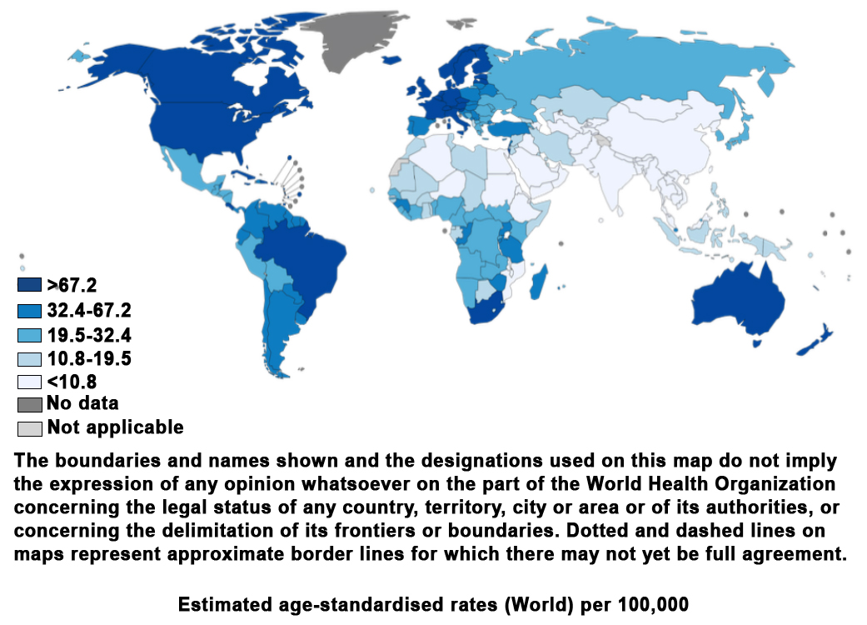
Worldwide Prostate Cancer Incidence
2/9
Estimated prostate cancer incidence worldwide in 2012¹
Prostate cancer is the second most common cancer in men, worldwide.¹
World Health Organization (WHO) estimated about 1.1 million cases of prostate cancer during 2012.¹
Adapted from GLOBOCAN, 2012¹
http://globocan.iarc.fr/Pages/fact_sheets_cancer.aspx. Accessed April 5, 2016.
Notes:
Worldwide prostate cancer incidence
Prostate cancer is the second most common cancer in men, worldwide. According to the World Health Organization (WHO), about 1.1 million men were diagnosed with prostate cancer in 2012. Worldwide incidence rates varied more than 25-fold, with about 70% cases reported in developed countries. This trend can be attributed to the higher PSA testing and biopsy rates.¹ /p1-2
Reference:
GLOBOCAN 2012: Estimated cancer incidence, mortality and prevalence worldwide in 2012. International Agency for Research on Cancer Web site. http://globocan.iarc.fr/Pages/fact_sheets_cancer.aspx. Accessed April 5, 2016.

Slide 23
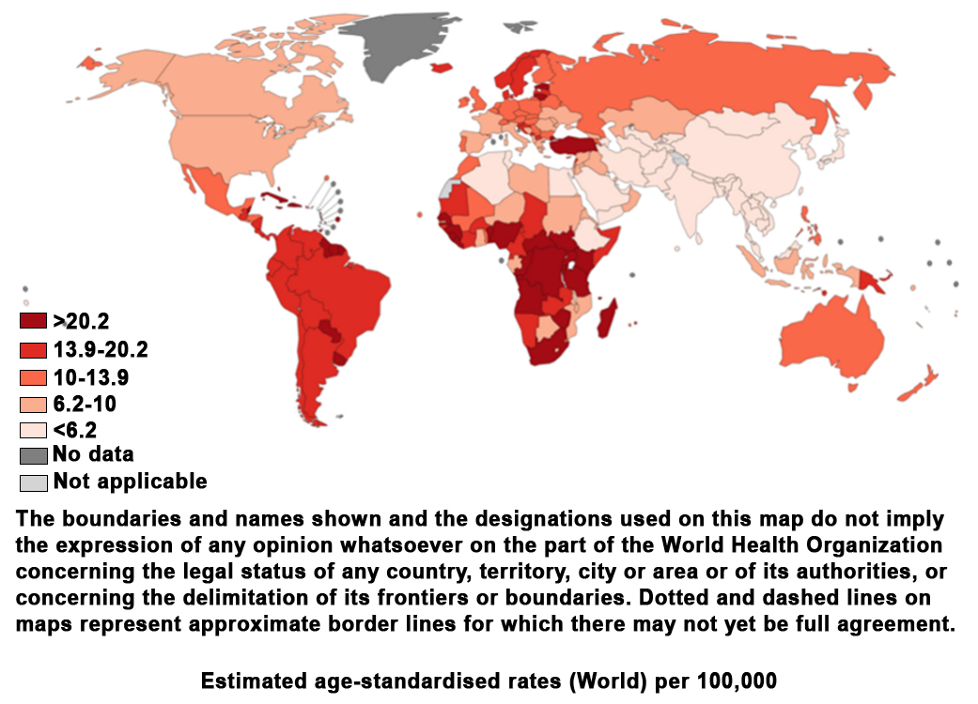
Worldwide Prostate Cancer Mortality
3/9
Estimated prostate cancer mortality worldwide in 2012¹
Prostate cancer is the fifth leading cause of death from cancer in men, worldwide.¹
Mortality rates are higher in less developed regions than in more developed regions.¹
Adapted from GLOBOCAN, 2012¹
http://globocan.iarc.fr/Pages/fact_sheets_cancer.aspx. Accessed April 5, 2016.
Notes:
Worldwide prostate cancer mortality
Prostate cancer is the fifth leading cause of death from cancer in men, worldwide. Mortality rates are higher in less developed regions (e.g., Caribbean, Sub-Saharan Africa) than in more developed regions (e.g., South-Central Asia).¹ /p2,5
Reference:
GLOBOCAN 2012: Estimated cancer incidence, mortality and prevalence worldwide in 2012. International Agency for Research on Cancer Web site. http://globocan.iarc.fr/Pages/fact_sheets_cancer.aspx. Accessed April 5, 2016.

Slide 24

Prostate Cancer Incidence
4/9
Prostate cancer incidence is on the rise¹
Causes of this rise may include¹:
Heightened awareness and screening
Adoption of westernised lifestyle
Prostatectomy/biopsy
Wide variation in prostate cancer rates noted internationally¹
Causes of variation include¹:
Different detection techniques
Treatment variation
Lifestyle factors
Genetic factors
Center MM, et al. Eur Urol. 2012;61(6):1079-1092.
Notes:
Prostate cancer incidence
The incidence of prostate cancer is on the rise worldwide.¹ /p1079/col1/para1 This rise may be attributed to the heightened awareness and increased screening using the PSA blood test. However, the incidence has also been on the rise in countries such as Thailand and Singapore where testing for PSA is relatively uncommon. The latter could plausibly be a result of adoption of a westernised lifestyle. On the other hand, the rise in incidence of prostate cancer in Uganda may be attributed to increased awareness of prostate cancer and detection of cancer during routine prostatectomy or histological examination of biopsies among the elderly population.¹ /p1088/col1/para2, /col2/para1
There is a wide variation in prostate cancer rates internationally. The causes of this variation include different detection techniques, treatment variation, genetic factors as well as lifestyle choices.¹ /p1079/col2/para1, /p1080/col1/para1, /p1085/col2/para1, /p1086/col1/para2
Reference:
Center MM, Jemal A, Lortet-Tieulent J, et al. International variation in prostate cancer incidence and mortality rates. Eur Urol. 2012;61(6):1079-1092. doi:10.1016/j.eururo.2012.02.054.

Slide 25
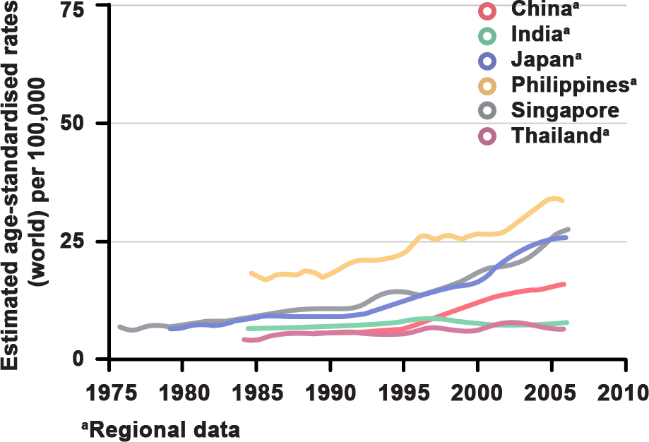
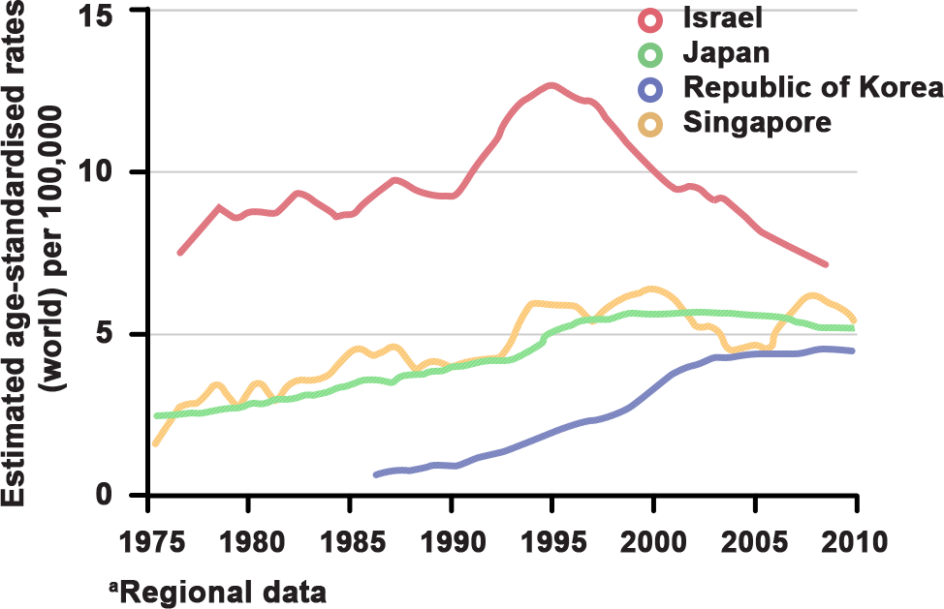
Trends in Prostate Cancer: Asia
5/9
Trends in incidence and mortality of prostate cancer¹
(A) Incidence of prostate cancer
(B) Mortality
Adapted from GLOBOCAN, 2012¹
Asia shows the lowest prostate cancer rates worldwide.¹
Republic of Korea shows increasing mortality rate.²
Japan shows decreasing mortality rates.²
Singapore reports stable mortality trends.²
http://globocan.iarc.fr/Pages/fact_sheets_cancer.aspx. Accessed April 5, 2016.
Center MM, et al. Eur Urol. 2012:1079-1092.
Notes:
Trends in prostate cancer in Asia
The graphs represent the estimated age-adjusted incidence and mortality rates per 100,000 patients from population-based cancer registries representing specific regions (extracted from data collected from the Cancer Incidence in Five Continents series). Prostate cancer incidence rates and time trends (by year) are obtained from the estimates made at the International Agency for Research on Cancer (IARC) as compiled in GLOBOCAN (2012).
Asia has among the lowest prostate cancer rates worldwide. Even so, incidence rates in most countries have consistently increased over the years.¹ /p4 On the other hand, mortality trends have shown variation in the same countries, with the Republic of Korea showing increasing mortality rates, Israel and Japan showing decreasing mortality rates and Singapore reporting rather stable mortality trends.² /p1084/col1/para3
References:
GLOBOCAN 2012: Estimated cancer incidence, mortality and prevalence worldwide in 2012. International Agency for Research on Cancer. http://globocan.iarc.fr/Pages/fact_sheets_cancer.aspx. Accessed April 5, 2016.
Center MM, Jemal A, Lortet-Tieulent J, et al. International variation in prostate cancer incidence and mortality rates. Eur Urol. 2012:1079-1092. doi:10.1016/j.eururo.2012.02.054.

Slide 26
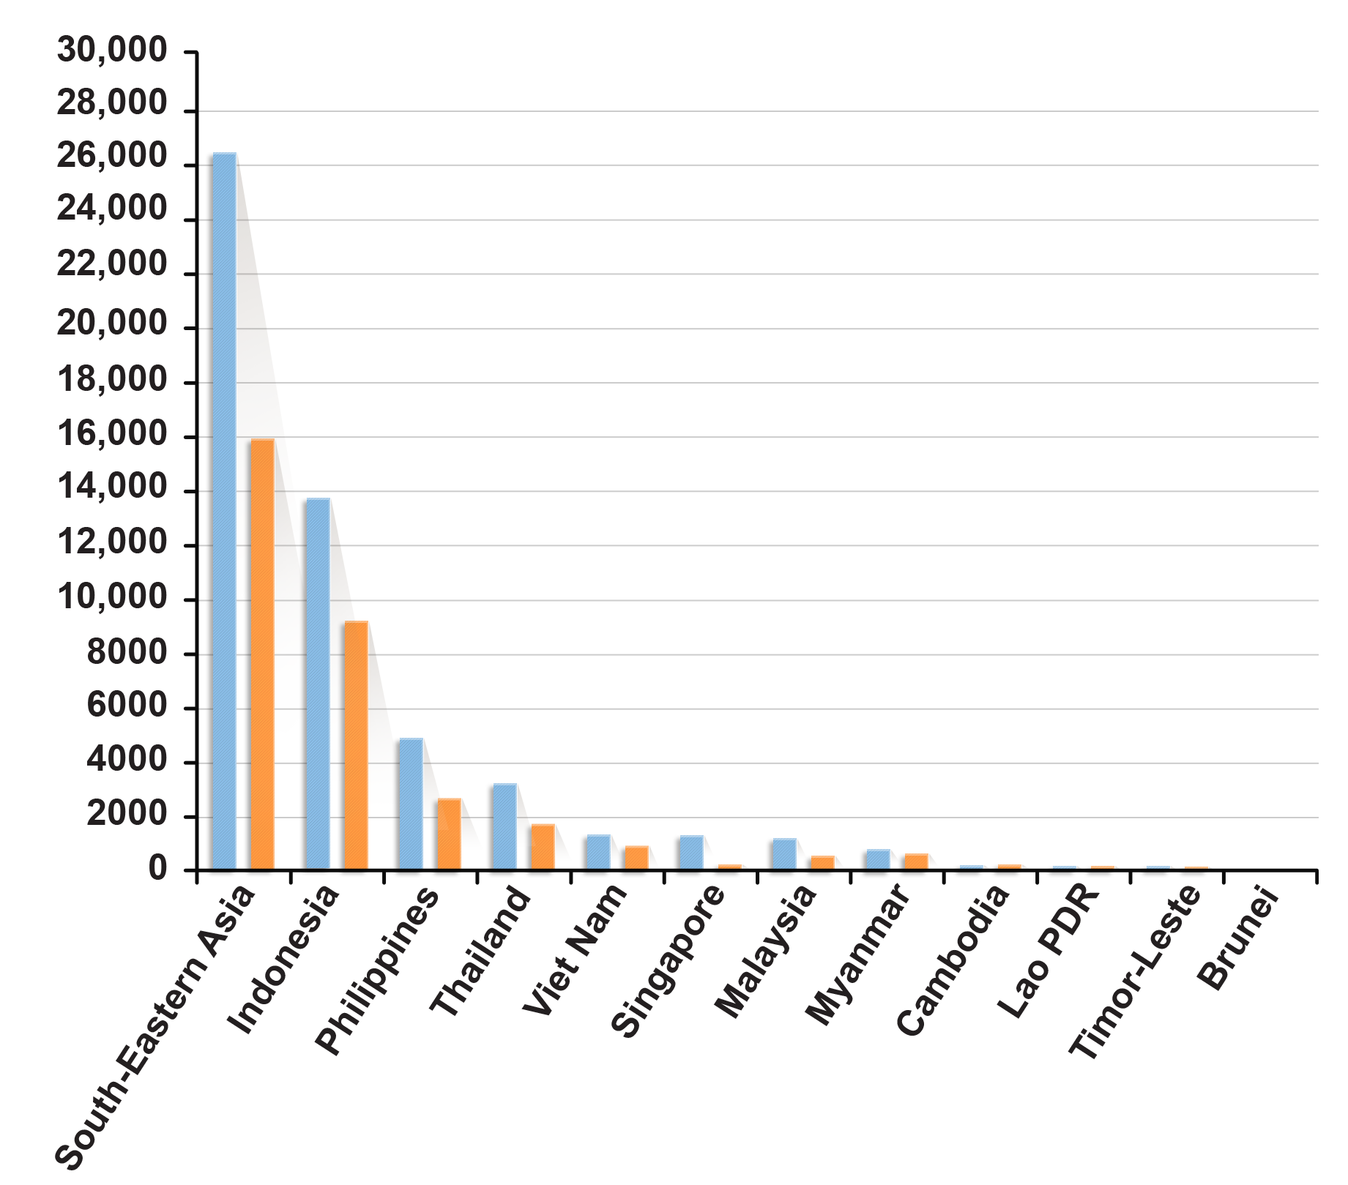
Trends in Prostate Cancer: Southeast Asia
6/9
Trends in incidence and mortality of prostate cancer in Southeast Asia¹
Prostate, all ages
Incidence
Number
Mortality
Globocan 2012(IARC) (5.5.2016)
Adapted from GLOBOCAN, 2012¹
http://globocan.iarc.fr/old/bar_site.asp?selection=24191&title=Prostate&sex=1&statistic=0&populations=12&window=1&grid=1&orientation=1&color1=5&color1e=&color2=4&color2e=&submit=%C2%A0Execute. Accessed April 5, 2016.
Notes:
Trends in prostate cancer in Southeast Asia
The graph represents the trends in incidence of and mortality due to prostate cancer in patients of all ages in Southeast Asia.¹ /p1
It is important to remember that an increasing trend of prostate cancer incidence and mortality is seen in Southeast Asia (Republic of Korea).
Reference:
GLOBOCAN 2012: Estimated cancer incidence, mortality and prevalence worldwide in 2012. International Agency for Research on Cancer. http://globocan.iarc.fr/old/bar_site.asp?selection=24191&title=Prostate&sex=1&statistic=0&populations=12&window=1&grid=1&orientation=1&color1=5&color1e=&color2=4&color2e=&submit=%C2%A0Execute. Accessed April 5, 2016.

Slide 27
Knowledge Check (6)
7/9
Fill in the blank:
The majority of prostate cancer cases are diagnosed in men _______ of age.
>45 years
>50 years
>60 years
>65 years
>65 years
Notes:
Knowledge check (6)
Fill in the blank:
The majority of prostate cancer cases are diagnosed in men _______ of age.
>45 years
>50 years
>60 years
>65 years
Answer: 4. The majority of prostate cancer cases are diagnosed in men >65 years of age.

Slide 28
Knowledge Check (7)
8/9
There is a wide variation in worldwide prostate cancer incidence rates. Which of the following factors contribute to this variation?
Lifestyle factors
Genetic factors
Treatment factors
All of the above
All of the above
Notes:
Knowledge check (7)
There is a wide variation in worldwide prostate cancer incidence rates. Which of the following factors contribute to this variation?
Lifestyle factors
Genetic factors
Treatment factors
All of the above
Answer: 4. Lifestyle factors, genetic factors and treatment factors contribute to the worldwide variation in prostate cancer incidence rates.

Slide 29
Knowledge Check (8)
9/9
Which Asia-Pacific country shows increasing trends in mortality rates?
Japan
Singapore
Republic of Korea
All of the above
Republic of Korea
Notes:
Knowledge check (8)
Which Asia-Pacific country shows increasing trends in mortality rates?
Japan
Singapore
Republic of Korea
All of the above
Answer: 3. The Republic of Korea shows highest mortality trends compared to other Southeast-Asian countries.

Slide 30
Diagnosis and Screening Guidelines for Prostate Cancer

Slide 31
Screening for Prostate Cancer
1/10
Prostate cancer screening with the PSA test remains controversial.¹
Findings from a Cochrane review (2014)¹
Screening is associated with an increase in prostate cancer diagnosis.
Screening is associated with the detection of more localised disease and less advanced disease.
Screening is associated with over-diagnosis and over-treatment.
Screening is not associated with survival benefit.
Impact on the quality of life of patients is unclear.
Recommendations
US Preventive Services Task Force recommends against PSA-based screening for prostate cancer in men.²
The European Association of Urology (EAU) recommends PSA testing in men after counselling on the potential risks and benefits of screening and individualising risk-adapted strategies for early detection in men with at least a 10-15 years life expectancy.^{1,3}
http://uroweb.org/wp-content/uploads/09-Prostate-Cancer_LR.pdf. Accessed April 8, 2016.
Moyer VA, et al. Ann Intern Med. 2012;157(2):120-134.
https://uroweb.org/guideline/prostate-cancer/. Accessed May 3, 2016.
Notes:
Screening for prostate cancer
Prostate cancer screening with the PSA test remains controversial.¹ /p19/para3-6. There is insufficient evidence to support routine PSA blood test and/or DRE causes prostate cancer. Results from a recent Cochrane review (2014) based on an up-to-date literature search (up to 2012) concluded that while screening is associated with the detection of more localised disease, its impact on the quality of life is unclear. In addition, there is no survival benefit associated with the screening for prostate cancer. The review also noted that the screening was associated with over-diagnosis and over-treatment of patients.¹ /p19/para3-6 Based on this and other similar studies, various organisations have provided recommendations when it comes to screening.
Therefore, it is important to remember that increased surveillance is associated with over-diagnosis and over-treatment of the disease.
The US Preventive Services Task Force recommends against PSA-based screening for prostate cancer in men.² /p121/Fig1
The European Association of Urology (EAU) recommends PSA testing in men after counselling on the potential risks and benefits of screening and individualising risk-adapted strategies for early detection in men with at least a 10- to 15-year life expectancy.^{1,3} /p19/para8, /p6/Table5.1.1
References:
Mottet N, Bellmunt J, Briers E, et al. Guidelines on prostate cancer. European Association of Urology Web site. http://uroweb.org/wp-content/uploads/09-Prostate-Cancer_LR.pdf. Accessed April 8, 2016.
Moyer VA, U.S. Preventive Services Task Force. Screening for prostate cancer: U.S. Preventive Services Task Force recommendation statement. Ann Intern Med. 2012;157(2):120-134. doi:10.7326/0003-4819-157-2-201207170-00459.
Prostate cancer. European Association of Urology Web site. https://uroweb.org/guideline/prostate-cancer/. Accessed May 3, 2016.

Slide 32

EAU Guidelines for Screening of Prostate Cancer
2/10
Guidelines for screening and early detection¹
Guideline
recommendations
An individualised risk-adapted strategy for
early detection might be offered to a well-informed man with a good performance
status and at least a 10- to 15-year life expectancy.
Early PSA testing
should be offered to men at elevated risk for prostate cancer. Risk groups are:
Men > 50 years
Men > 45 years and a family history of prostate cancer
African-Americans
Men with PSA level > 1 ng/mL at 40 years
Men with PSA level > 2 ng/mL at 60 years
A risk-adapted strategy might be considered (based on the initial PSA level), which may be every 2 years for those initially at risk, or postponed up to 8
years in those not at risk.
The age at which early diagnosis of prostate cancer should be stopped is influenced by life expectancy and performance status.
Men who have < 15 years of life expectancy are unlikely to benefit based on PIVOT and ERSPC trials.
LE
3
2B
3
3
GR
B
A
C
A
ERSPC, European randomized study of screening for prostate cancer; GR, grade of recommendation; LE, level of evidence; PIVOT, prostate cancer intervention versus observation trial; PSA, prostate-specific antigen.
Adapted from Mottet, 2015¹
http://uroweb.org/wp-content/uploads/09-Prostate-Cancer_LR.pdf. Accessed April 8, 2016.
Notes:
EAU guidelines for screening of prostate cancer
The table lists the detailed EAU guidelines for prostate cancer screening.¹ /p20/Table5.1.1
Note:
Levels of evidence (LE)²: /p2/col1/Table
1A: Evidence from meta-analysis of randomised controlled trials
1B: Evidence from at least one randomised controlled trial
2A: Evidence from at least one controlled study without randomisation
2B: Evidence from at least one other type of quasi-experimental study
3: Evidence from non-experimental descriptive studies, such as comparative studies, correlation studies and case reports.
Grade of recommendation (GR)²: /p2/col1/Table
A: Directly based on level 1 evidence
B: Directly based on level 2 evidence or extrapolated recommendations from level 1 evidence
C: Directly based on level 3 evidence or extrapolated recommendations from level 1 or 2 evidence
References:
Mottet N, Bellmunt J, Briers E, et al. Guidelines on prostate cancer. European Association of Urology Web site. http://uroweb.org/wp-content/uploads/09-Prostate-Cancer_LR.pdf. Accessed April 8, 2016.
Wang C, Nieschlag E, Swerdloff RS, et al. ISA, ISSAM, EAU, EAA and ASA recommendations: investigation, treatment and monitoring of late-onset hypogonadism in males. Aging Male. 2009;12(1):5-12. doi:10.1080/13685530802389628.

Slide 33
EAU Guidelines for Prostate Cancer Diagnosis
3/10
Clinical diagnosis of prostate cancer^{1,2}
Undertake biopsy?
Elevated PSA
Suspicious DRE
Other factors to be considered:
Age
Comorbidities
Therapeutic consequences
TRUS or perineal biopsy
10-12 cores to be obtained for initial analysis
Biopsies to be guided by ultrasound
Suspicion of prostate cancer
Suspicious DRE
Elevated serum PSA
Treatment
Surgery
Radiotherapy
Hormonal therapy
Chemotherapy
Gleason score
Grading of biopsy cores to predict aggressiveness of the disease based on 2005 and 2014 ISUP guidelines
Staging
Determine if cancer is
localised or metastatic
DRE, digital rectum exam; ISUP, International Society of Urological Pathology; PSA, prostate-specific antigen; TRUS, transrectal ultrasound.
http://uroweb.org/wp-content/uploads/09-Prostate-Cancer_LR.pdf. Accessed April 8, 2016.
https://uroweb.org/guideline/prostate-cancer/#4. Accessed April 7, 2016.
Notes:
EAU guidelines for prostate cancer diagnosis
Prostate cancer can only be definitively diagnosed by the presence of adenocarcinoma in prostate biopsy cores or operative specimens.¹ /p20/para8 The decision to undertake a prostate biopsy is based on an elevated PSA level or a suspect DRE. Other factors that may be considered include age, comorbidities and therapeutic consequences. An elevated PSA level should be confirmed with a repeat test before deciding on a biopsy. Ultrasound biopsy is now considered as a standard of care. The urologist may use either a transrectal approach or a perineal approach. A minimum of 10 to 12 core samples are recommended. The Gleason score is the single strongest prognostic factor for clinical behaviour and treatment response, and the cancer should be graded according to recommendations by the International Society of Urological Pathology (ISUP) 2005 and ISUP 2015. Staging is done to determine the aggressiveness of the cancer using the tumour, node, metastasis (TNM) classification system.^{1,2} /p18/Table 4.1.1, /p22/para3-5, /p22/para9, /p26/para2, p4/para1, /p5/para1-3, /p5/Table4.2.1, /p6/Table 4.2.1, /p6/Table4.2.2 Treatment is initiated upon completion of all these steps.
It is important to study the first line of diagnostic tests in more detail.
References:
Mottet N, Bellmunt J, Briers E, et al. Guidelines on prostate cancer. European Association of Urology Web site. http://uroweb.org/wp-content/uploads/09-Prostate-Cancer_LR.pdf. Accessed April 8, 2016.
Mottet N, Bellmunt J, Briers E. et al. EAU Prostate Cancer guidelines. European Association of Urology Web site. https://uroweb.org/guideline/prostate-cancer/#4. Accessed April 7, 2016.

Slide 34
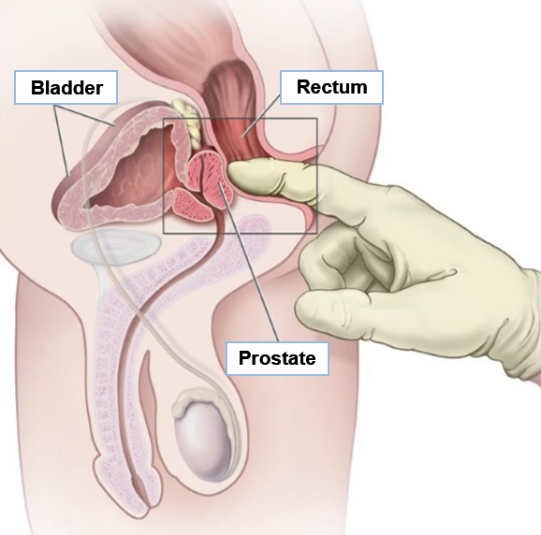
Digital Rectal Exam
4/10
DRE focuses on prostate size and prostate abnormalities.¹
20%-25% of men with an abnormal DRE have prostate cancer.¹
Most prostate cancers are located in the peripheral zone of the prostate and can be palpated on DRE when the volume is ≥0.2 mL.²
Suspect DRE²
Detects prostate cancer in 18% of patients irrespective of the PSA level²
Has a positive predictive value of 5%-30% in patients with a PSA level of ≤ 2 ng/mL²
Is a strong indication for prostate biopsy²
Digital rectal examination³
Adapted from Prostate Cancer Treatment, 2016³
Scher HI, et al. Harrison’s Principles of Internal Medicine. Vol. 1. 19th ed. New York, NY: McGraw-Hill Education; 2015:579-587.
http://uroweb.org/wp-content/uploads/09-Prostate-Cancer_LR.pdf. Accessed April 8, 2016.
http://www.cancer.gov/types/prostate/patient/prostate-treatment-pdq. Accessed May 12, 2016.
Notes:
Digital rectal exam
The DRE focuses on prostate size and any abnormalities that lie within or beyond the prostate.¹ /p580/col2/para5 In all, 20% to 25% men with an abnormal DRE have prostate cancer.¹ /p580/col2/para5 Most prostate cancers are located in the peripheral zone of the prostate and may be detected by DRE when the volume is ≥0.2 mL.² In about 18% of all patients, prostate cancer is detected by a suspect DRE alone, irrespective of the PSA level.¹ A suspect DRE in patients with a PSA level of ≤2 ng/mL has a positive predictive value of 5% to 30%.² A suspect DRE is a strong indication for prostate biopsy as it is predictive of a higher Gleason score and aggressive prostate cancer.² /p21/para1
References:
Scher HI, Eastham JA. Benign and malignant diseases of the prostate. In: Kasper DL, Fauci AS, Hauser SL, Longo DL, Jameson JL, Loscalzo J, eds. Harrison’s Principles of Internal Medicine. Vol. 1. 19th ed. New York, NY: McGraw-Hill Education; 2015:579-587.
Mottet N, Bellmunt J, Briers E, et al. Guidelines on prostate cancer. European Association of Urology Web site. http://uroweb.org/wp-content/uploads/09-Prostate-Cancer_LR.pdf. Accessed April 8, 2016.

Slide 35
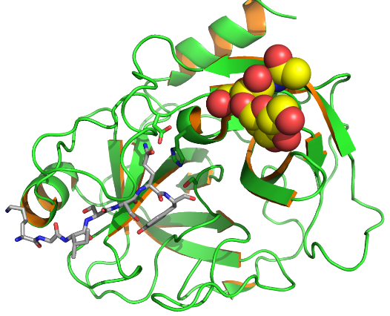
Prostate-Specific Antigen
5/10
A kallikrein-like serine protease produced by prostate epithelial cell¹
Organ-specific, not cancer-specific¹
May be elevated in nonmalignant conditions such as BPH and prostatitis¹
Values are affected by biopsy, but not DRE¹
A continuous parameter; the higher the value, the likelier the presence of prostate cancer²
Does not have a universally accepted cut-off or upper limit of normal threshold²
Total serum PSA levels may help to discriminate BPH from prostate cancer²
PSA velocity and doubling time may have a prognostic role in patients with treated prostate cancer²
Crystallographic structure of human PSA^{3,4}
Adapted from Menez, 2008³; Wikimedia Commons, 2016⁴
Scher HI, et al. Harrison’s Principles of Internal Medicine. Vol. 1. 19th ed. New York, NY: McGraw-Hill Education; 2015:579-587.
http://uroweb.org/wp-content/uploads/09-Prostate-Cancer_LR.pdf. Accessed April 8, 2016.
Menez R, et al. J Mol Biol. 2008;376(4):1021-1033.
https://commons.wikimedia.org/wiki/File:PSA_KLK3_PDB_2ZCK.png. Accessed May 18, 2016.
Notes:
Prostate-specific antigen
PSA is produced almost exclusively by the epithelial cells of the prostate. As it is produced by both malignant and nonmalignant epithelial cells, it is organ-specific but not cancer-specific. Serum PSA may be elevated in the presence of BPH, prostatitis and other nonmalignant conditions.¹ /p581/col1/para1
PSA levels can remain elevated up to 10-fold for 8 to 10 weeks following a biopsy, but they are unaffected by a recent DRE.¹ /p581/col1/para1 The level of PSA is a continuous parameter; the higher its value, the likelier the patient has prostate cancer. However, low levels of serum PSA do not definitively preclude a prostate cancer diagnosis.² /p21/para2-3
In addition to total serum PSA levels, the ratio of free (f) to total (t) PSA ratio (f/t PSA) can help to discriminate BPH from prostate cancer; a lower f/t PSA predicts a higher likelihood of cancer.² /p21/para7 The PSA velocity [defined as an absolute annual increase in serum PSA (ng/mL per year)] and the PSA doubling time (a measure of exponential increase of serum PSA over time, reflecting a relative change) may have a prognostic role in patients with treated prostate cancer but are of limited use in the diagnosis.² /p21/para5-6
References:
Scher HI, Eastham JA. Benign and malignant diseases of the prostate. In: Kasper DL, Fauci AS, Hauser SL, Longo DL, Jameson JL, Loscalzo J, eds. Harrison’s Principles of Internal Medicine. Vol. 1. 19th ed. New York, NY: McGraw-Hill Education; 2015:579-587.
Mottet N, Bellmunt J, Briers E, et al. Guidelines on prostate cancer. European Association of Urology Web site. http://uroweb.org/wp-content/uploads/09-Prostate-Cancer_LR.pdf. Accessed April 8, 2016.

Slide 36
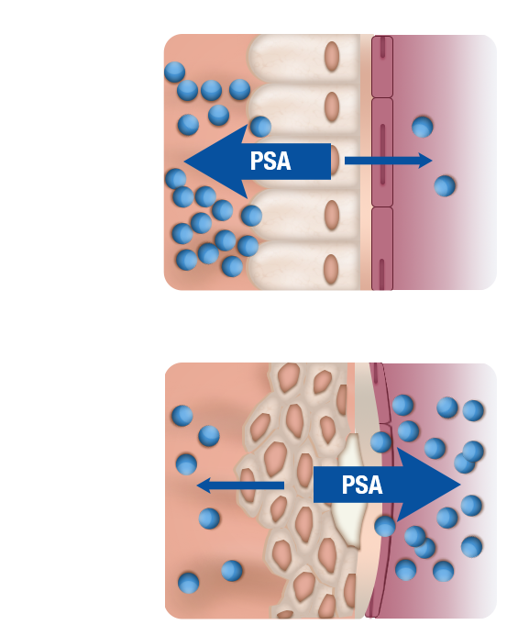
Clinical Use of PSA Testing
6/10
Comparison of normal and prostate cancer PSA³
Prostate gland
Blood vessel
Prostate cancer is detected despite low PSA levels.¹
Other tests to improve specificity include:
Ratio of free to total PSA (f/t PSA)^{1,2}
Prostate cancer antigen 3 (PCA3) biomarker¹
PSA density¹
PSA velocity¹
PSA doubling time¹
Normal
Cells in the prostate are organised in a tight pattern, only a small amount of PSA leaks out of the prostate and into the blood stream
With prostate cancer
Cells in the prostate are disorganised and the layers between the prostate and the blood vessel are disrupted, more PSA leaks out of the prostate and into the blood stream
PSA, prostate-specific antigen.
Adapted from The PSA Test, 2016³
http://uroweb.org/wp-content/uploads/09-Prostate-Cancer_LR.pdf. Accessed April 8, 2016.
Heidenreich A, et al. Eur Urol. 2014;65(1):124-137.
http://myprostate.ie/the-psa-test/. Accessed May 3, 2016.
Notes:
Clinical use of PSA testing
In many cases, prostate cancer is present even with a low serum PSA.¹ /p21/para3, Table 5.2.1 Several modifications to the PSA test have been suggested to improve its specificity in the early detection of prostate cancer.² /p126/col2/para2-4
Recent studies indicate that using f/t PSA values limits the number of unnecessary biopsies and increases the detection rate of prostate cancer. It should be considered in patients with suspect PSA levels.² /p126/col2/para2-4 It is able to stratify the risk of prostate cancer in men with PSA levels between 4 and 10 ng/mL and a negative DRE.¹ /p21/para7
Prostate cancer antigen 3 (PCA3) is a mRNA biomarker that is prostate-specific.¹ It is detectable in urine samples obtained after 3 strokes of prostatic massage during DRE. PCA3 is superior to total and percent-free PSA for the detection of prostate cancer in men with elevated PSA.¹ /p22/para1-2
PSA density is the ratio of serum PSA and TRUS-determined prostate volume and its value is directly proportional to the likelihood of the presence of clinical prostate cancer.¹ /p21/para4
Both PSA velocity (PSA-V), which is the annual increase in serum PSA, and PSA doubling time (PSA-DT), which measures the exponential increase in serum PSA over time, may have some prognostic value but have limited use in the diagnosis of prostate cancer.¹ /p21/para5-6
References:
Mottet N, Bellmunt J, Briers E, et al. Guidelines on prostate cancer. European Association of Urology Web site. http://uroweb.org/wp-content/uploads/09-Prostate-Cancer_LR.pdf. Accessed April 8, 2016.
Heidenreich A, Bastian PJ, Bellmunt J, et al. EAU guidelines on prostate cancer. part 1: screening, diagnosis, and local treatment with curative intent-update 2013. Eur Urol. 2014;65(1):124-137. doi:10.1016/j.eururo.2013.09.046.

Slide 37
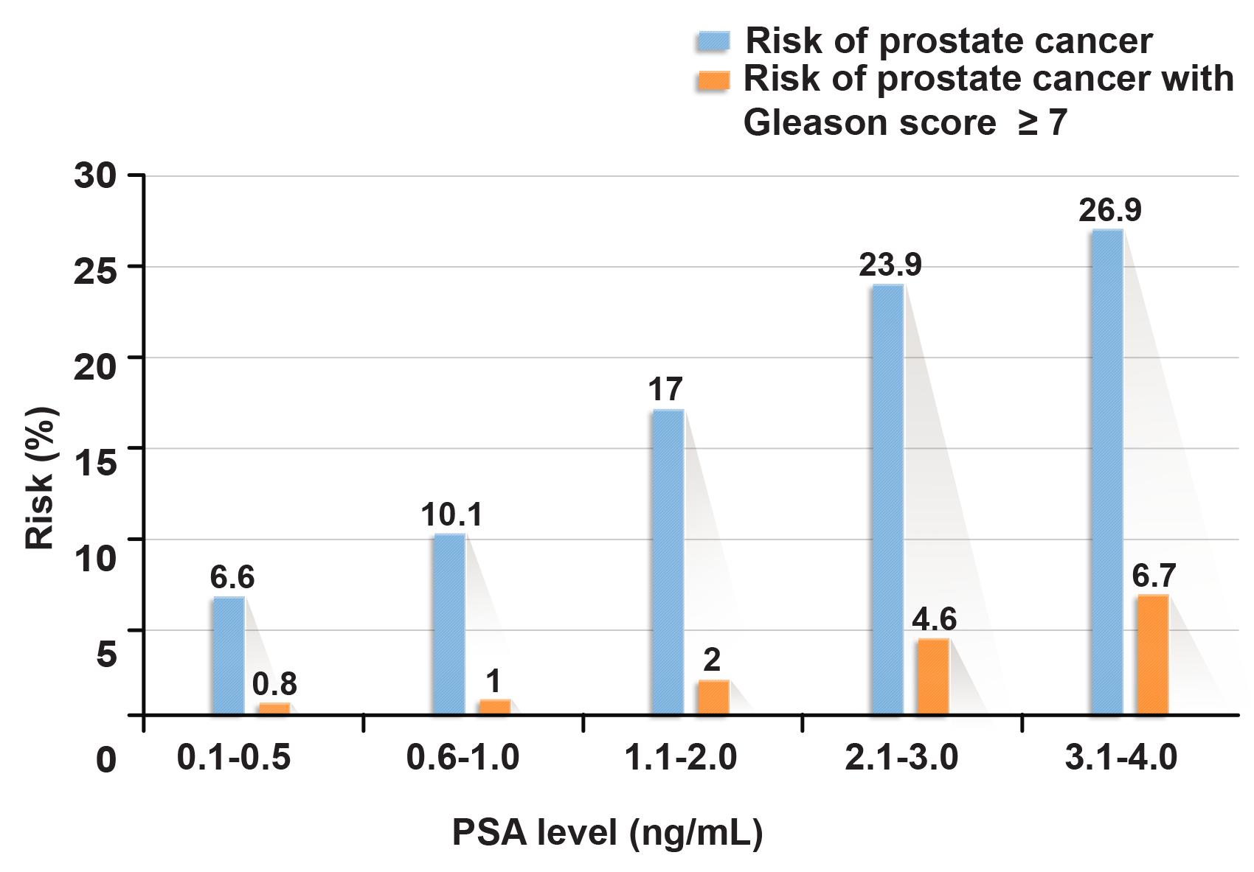
Clinical Use of PSA Testing (cont.)
7/10
Risk of prostate cancer in relation to low PSA values¹
http://uroweb.org/wp-content/uploads/09-Prostate-Cancer_LR.pdf. Accessed April 8, 2016.
Notes:
Clinical use of PSA testing (cont.)
In many cases, prostate cancer is present even with a low serum PSA.¹ /p21/para3, Table 5.2.1 The findings in the graph clearly demonstrate the occurrence of aggressive prostate cancer even at very low PSA levels, precluding an optimal PSA threshold value for detecting non-palpable but clinically significant prostate cancer.
Therefore, it is important to remember that the detection of PSA level alone may not be enough as a diagnosis tool for prostate cancer.
Nomograms may be used to reduce the number of unnecessary prostate biopsies.¹ /p21/para3
Let us now move on to understanding how prostate tumours are classified. Understanding the classification is essential to determine the degree of aggressiveness of the cancer and the therapeutic plan for the patient.
Reference:
Mottet N, Bellmunt J, Briers E, et al. Guidelines on prostate cancer. European Association of Urology Web site. http://uroweb.org/wp-content/uploads/09-Prostate-Cancer_LR.pdf. Accessed April 8, 2016.

Slide 38
Knowledge Check (9)
8/10
Arrange the following diagnostic techniques in the order of their use for the initial diagnosis of prostate cancer.
1. Staging
2. Biopsy
3. Patient history
4. Gleason scoring
5. DRE/PSA
1. Patient history
2. DRE/PSA
3. Biopsy
4. Gleason scoring
5. Staging
DRE, digital rectum exam; PSA, prostate-specific antigen.
Notes:
Knowledge check (9)
If you were to diagnose a patient, what would you begin with?
Arrange the following diagnostic techniques in the order of their use for the initial diagnosis of prostate cancer.
Staging
Biopsy
Patient history
Gleason scoring
DRE/PSA
Answer: 3, 5, 2, 4, 1. Diagnosis may be arrived at by using the diagnostic techniques in the following order:
Patient history
DRE/PSA
Biopsy
Gleason scoring
Staging
DRE, digital rectum exam; PSA, prostate-specific antigen.

Slide 39
Knowledge Check (10)
9/10
To screen or not to screen: that is the question.
Of the following 4 patients, choose the ones who should be screened for prostate cancer.
1. Bob: Caucasian, 70 years, PSA 1 ng/mL
2. Jian: Asian, 42 years, PSA 2 ng/mL
3. Ron: African-American, 45 years, PSA 2 ng/mL
4. Stu: Hispanic, 82 years, PSA 1.5 ng/mL
1. Bob: Caucasian, 70 years, PSA 1 ng/mL
2. Jian: Asian, 42 years, PSA 2 ng/mL
3. Ron: African-American, 45 years, PSA 2 ng/mL
4. Stu: Hispanic, 82 years, PSA 1.5 ng/mL
PSA, prostate-specific antigen.
Notes:
Knowledge check (10)
This question is designed to understand whether a patient need to be screened for prostate cancer.
Of the following 4 patients, choose the ones who should be screened for prostate cancer.
Bob: Caucasian, 70 years, PSA 1 ng/mL
Jian: Asian, 42 years, PSA 2 ng/mL
Ron: African-American, 45 years, PSA 2 ng/mL
Stu: Hispanic, 82 years, PSA 1.5 ng/mL
Answer: 1, 2, 3 and 4. It was a tricky question! If one follows the EAU guidelines, all the patients must be screened in this case. All 4 men fall in the risk category as defined by the EAU guidelines. Bob and Stu are over 55 years of age, Ron is African-American and Jian has a PSA >1 ng/mL and is in his 40s.
PSA, prostate-specific antigen.

Slide 40

Knowledge Check (11)
10/10
State whether the following statements about PSA are true or false.
A normal PSA level is any value below 4 ng/mL.
PSA levels are organ-specific.
PSA levels are elevated in cases of BPH.
PSA levels remain higher for 6 to 8 weeks following a DRE.
FALSE
TRUE
TRUE
FALSE
BPH, benign prostatic hyperplasia; DRE, digital rectum exam; PSA, prostate-specific antigen.
Notes:
Knowledge check (11)
State whether the following statements about PSA are true or false.
A normal PSA level is any value below 4 ng/mL.
PSA levels are organ-specific.
PSA levels are elevated in cases of BPH.
PSA levels remain higher for 6 to 8 weeks following a DRE.
Answer:
False. PSA value does not have any universally accepted cut-off or upper limit of
normal threshold.
True
True
False. PSA values are not affected by DRE.
BPH, benign prostatic hyperplasia; DRE, digital rectum exam; PSA, prostate-specific antigen.

Slide 41
Staging and Classification of Prostate Cancer

Slide 42
EAU Guidelines for Prostate Cancer Staging
1/10
Guidelines for staging of prostate cancer¹
Prostate cancer stage
Any risk group staging
Low-risk localised prostate cancer
Intermediate-risk prostate cancer
High-risk localised prostate cancer/high-risk locally advanced prostate cancer
Guidelines
Additional imaging if patient management changed
CT/TRUS not to be used for local staging
PET-scan not to be used for up-front staging
Guidelines
No additional imaging
Guidelines
Bone scan
Cross-sectional imaging
Guidelines
Prostate mpMRI for local staging
CT/MRI and bone scan for up-front staging
PET-scan not to be used for up-front staging
CT, computed tomography; mpMRI, multiparametric magnetic resonance imaging; PET, positron emission tomography; TRUS, transrectal ultrasound.
Adapted from Mottet, 2015¹
http://uroweb.org/wp-content/uploads/09-Prostate-Cancer_LR.pdf. Accessed April 8, 2016.
Notes:
EAU guidelines for prostate cancer staging
After evaluation by DRE and PSA, if there is need to further assess the extent of spread of prostate cancer, imaging techniques may be used. These include bone scanning, computed tomography (CT) scan, magnetic resonance imaging (MRI) or multiparametric MRI (mpMRI) to determine the extent of prostate cancer.¹ /p27/para5, /p30/Table5.3.5 Primarily, worldwide, the TNM system is used for staging.¹ /p18/Table4.1.2
Reference:
Mottet N, Bellmunt J, Briers E, et al. Guidelines on prostate cancer. European Association of Urology Web site. http://uroweb.org/wp-content/uploads/09-Prostate-Cancer_LR.pdf. Accessed April 8, 2016.

Slide 43
Prostate Cancer Staging: Tumour, Node, Metastasis Classification
2/10
TNM classification of prostate cancer¹
Primary tumour (T)
TX | Primary tumour cannot be assessed
T0 | No evidence of primary tumour
T1 | Clinically unapparent tumour not palpable or visible on imaging T1a: Histological finding in ≤5% of resected tissue T1b: Histological finding in >5% of resected tissue T1c: Tumour identified by needle biopsy
T2 | Tumour confined within prostate T2a: Tumour involves ≤50% of one lobe T2b: Tumour involves >50% of one lobe T2c: Tumour involves both lobes
T3 | Tumour extends through the prostatic capsule T3a: Extracapsular extension (unilateral or bilateral) including microscopic bladder neck involvement T3b: Tumour invades seminal vesicle(s)
T4 | Tumour is fixed or invades adjacent structures other than seminal vesicle
Regional lymph nodes (N)
NX | Regional lymph nodes cannot be assessed
N0 | No regional lymph node metastasis
N1 | Regional lymph node metastasis
Distant metastasis (M)
MX | Distant metastases cannot be assessed
M0 | No distant metastases
M1 | Distant metastases M1a: Non-regional lymph node(s) M1b: Bone(s) M1c: Other site(s)
TNM, tumour, node, metastasis.
Adapted from Mottet, 2015¹
http://uroweb.org/wp-content/uploads/09-Prostate-Cancer_LR.pdf. Accessed April 8, 2016.
Notes:
Prostate cancer staging: Tumour, node, metastasis classification
The current internationally accepted classification system is the TNM staging system. This system indicates the extent of the local disease (T), the status of the regional lymph nodes (N) and spread of the disease to distant organs or lymph nodes (M).¹ /p18/Table4.1.1
Tumour staging is as follows:
Stage TX: Primary tumour cannot be assessed
Stage T0: No evidence of primary tumour
Stages T1-2c: Disease confined to the prostate
Stage T3a: Extracapsular extension of the tumour
Stage T3b: Invasion of the seminal vesicles
Stage T4: Invasion of adjacent structures other than the seminal vesicle, such as the bladder neck, external sphincter, rectum and/or pelvic floor.
Lymph node involvement staging is as follows:
Stage NX: Regional lymph nodes cannot be assessed
Stage N0: No regional lymph node metastasis
Stage N1: Regional lymph node(s) metastasis
Distant metastatic involvement staging is as follows:
Stage MX: Distant metastases cannot be assessed
Stage M0: No distant metastases
Stage M1: Distant metastases
Stage M1a: Distant metastases other than regional lymph nodes
Stage M1b: Metastasis to bone(s)
Stage M1c: Metastasis to other site(s)
Prostate cancer can be differentiated into 4 stages. In stage I, cancer remains confined to the prostate only. In stage II, cancer becomes more advanced compared to stage I, but remains confined to the prostate gland. In stage III, the cancer spreads outside the prostate gland and may also invade the seminal vesicles. In stage 4, cancer spread to the surrounding tissues such as the rectum, bladder or pelvic wall.² /p4/para1 and 2, /p5/para3 and 4
References:
Mottet N, Bellmunt J, Briers E, et al. Guidelines on prostate cancer. European Association of Urology Web site. http://uroweb.org/wp-content/uploads/09-Prostate-Cancer_LR.pdf. Accessed April 8, 2016.
Prostate cancer treatment (PDQ®)–patient version. National Cancer Institute Web site. http://www.cancer.gov/types/prostate/patient/prostate-treatment-pdq#section/_120. Accessed May 26, 2016.

Slide 44
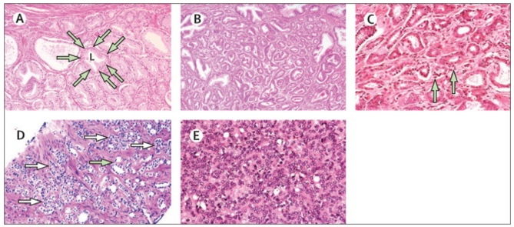
Histological Evaluation: Gleason Grading System
3/10
Gleason grade patterns for prostate cancer lesions¹
Gleason grading system is based on the pattern of tumour growth examined at a relatively low magnification.¹
Grading depend on patterns of growth in the order of increasing apparent histological malignancy (grades 1-5).¹
Gleason score is determined as the sum of these 2 patterns (primary and secondary pattern).²
L, lumen.
Adapted from Ahmed, 2012¹
(A) Gleason grade 1 (arrows outline an individual prostate acinus; original magnification ×40). (B) Gleason grade 2 (original magnification ×40). (C) Gleason grade 3 (arrows show a small amount of individual cell infiltration into surrounding stroma; original magnification ×100). (D) Gleason grade 4 (increased stromal invasion; white arrows show some areas of gland fusion and poorly defined lumens; green arrow shows one of a few areas in which Gleason pattern 3 is present; original magnification ×40). (E) Gleason grade 5 (solid sheets of cells with no glandular structures and poorly differentiated cells; original magnification ×100).
Ahmed HU, et al. Lancet Oncol. 2012;13(11):e509-e517.
http://www.ncbi.nlm.nih.gov/books/NBK66036/. Accessed April 9, 2016.
Notes:
Histological evaluation: Gleason grading system
During 1974, Donald F. Gleason created a widely used grading system for prostate cancer, solely based on the architectural pattern of the tumour.¹ /p45/col1/para1,3, /p46/col1/para2
Gleason used a system of histological grading based on the pattern of tumour growth examined at a relatively low magnification. He numbered 5 patterns of growth in the order of increasing apparent histological malignancy (grades 1-5); 1 being the most differentiated and 5 being the least differentiated.² /p511/col1/Fig2 He also pointed that grade 3 tumours rarely have associated metastases, but metastases are common with grade 4 or grade 5 tumours.
Due to histological variations in prostate tumours, 2 grades are recorded for each sample. The 2 grades are added together to produce a Gleason score. The predominant pattern (by area) is designated as the primary pattern while the not-so-predominant pattern (by area) is designated as the secondary pattern, and the Gleason score is determined as the sum of these 2 patterns (e.g., grade 4 + grade 3), with scores ranging from 2 to 10.³ /p3/para5 A score of 2 to 4 is rarely given. A score of 5 to 6 is considered to be low grade, 7 is considered to be intermediate grade and 8 to 10 is considered to be high grade.⁴ /p26/para4
Several studies confirm the Gleason score as a predictor for prostate cancer-related deaths.¹ /p47/col2/para2.
But, like any classification system, the Gleason system also had to be updated.
References:
Gevaert T, Van Poppel H, Joniau S, De Ridder D, Lerut E. Current perspectives on the use of the Gleason grading system for prostate cancer. Belg J Med Oncol. 2012;6:45-51. https://www.google.co.in/url?sa=t&rct=j&q=&esrc=s&source=web&cd=4&cad=rja&uact=8&ved=0ahUKEwidstuG7uXMAhWB6KYKHT2gBBgQFgg4MAM&url=http%3A%2F%2Fwww.ariez.nl%2FDownloadFile.lynkx%3Fguid%3D6b229744-19ee-4827-aca1-93ab26f469af&usg=AFQjCNGxoOmH9ffyQwtdq5pU-1wyC0yAFQ&bvm=bv.122448493,d.dGY. Accessed May 19, 2016.
Ahmed HU, Arya M, Freeman A, Emberton M. Do low-grade and low-volume prostate cancers bear the hallmarks of malignancy? Lancet Oncol. 2012;13(11):e509-e517. doi:10.1016/S1470-2045(12)70388-1.
PDQ Adult Treatment Editorial Board. Prostate cancer treatment (PDQ®): Health professional version. In: PDQ Cancer Information Summaries. Bethesda (MD): National Cancer Institute (US); 2002. http://www.ncbi.nlm.nih.gov/books/NBK66036/. Accessed April 9, 2016
PDQ Screening and Prevention Editorial Board. Prostate cancer screening (PDQ®): Health professional version. In: PDQ Cancer Information Summaries. Bethesda (MD): National Cancer Institute (US); 2002. http://www.ncbi.nlm.nih.gov/books/NBK65945/. Accessed April 9, 2016.

Slide 45
Modified Gleason Scoring System 2014 ISUP Update
4/10
ISUP 2014 grade groups¹
Gleason score
Grade group
Prostate cancer grouping is useful in taking effective treatment decisions²
Eliminate the anomaly that a Gleason score of 6 is indicative of a highly differentiated cancer²
Distinguish between prostate cancer with Gleason scores of (4 + 3) and (3 + 4)²
2-6
1
7 (3 + 4)
2
7 (4 + 3)
3
8 (4 + 4) or (3 + 5) or (5 + 3)
4
9-10
5
ISUP, International Society of Urological Pathology.
Adapted from Mottet, 2016¹
https://uroweb.org/guideline/prostate-cancer/#4. Accessed April 7, 2016.
Epstein JI, et al. Eur Urol. 2016;69(3):428-435.
Notes:
Modified Gleason scoring system 2014 ISUP update
The most recent (2014) update to the Gleason scoring system divides the Gleason scores into 5 groups. The new system classifies Gleason scores ≤ 6 into 1 group, Gleason scores of 7 into 2 groups—Group 2 (3 + 4) and Group 3 (4 + 3), Gleason scores of 8 into Group 4 and Gleason scores between 9 and 10 into Group 5.¹ /p4/para1, /p5/para1-3, /p5/Table4.2.1, /p6/Table4.2.1, /p6/Table4.2.2 The creation of separate groups from a single Gleason score of 7 is especially useful for taking effective treatment decisions. This is because a score of (3 + 4), which mostly represents well-differentiated cancer with a lesser proportion of poorly differentiated cancer, has a prognosis quite different from a score of (4 + 3), which mostly represents poorly differentiated cancer with a lesser proportion of well-differentiated cancer.² /p428/col1/para1-2
The new system offers 2 major benefits: Firstly, patients with a Gleason score of 6 (so far misunderstood to have their cancer in the middle of the scale) are now categorised into the lowest risk category, grade 1, which will help allay their fears. Instead of classifying a Gleason score of 6 as noncancerous (which is untrue in many cases), assigning it a grade 1 on a scale of 1 to 5 will help to define the indolent nature of the cancer and set up a surveillance strategy for the appropriate patient. Secondly, this system may decrease the trends of overtreatment of low-grade prostate cancer that had been detected by PSA screening.² /p429/col2/para1-2, /p433/col1/para2-3
References:
Mottet N, Bellmunt J, Briers E. et al. EAU Prostate Cancer guidelines. European Association of Urology Web site. https://uroweb.org/guideline/prostate-cancer/#4. Accessed April 7, 2016.
Epstein JI, Zelefsky MJ, Sjoberg DD, et al. A contemporary prostate cancer grading system: a validated alternative to the Gleason score. Eur Urol. 2016;69(3):428-435. doi:10.1016/j.eururo.2015.06.046.

Slide 46
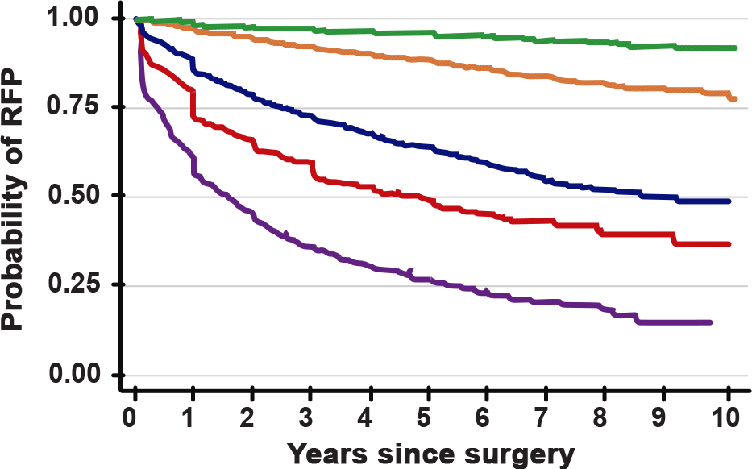
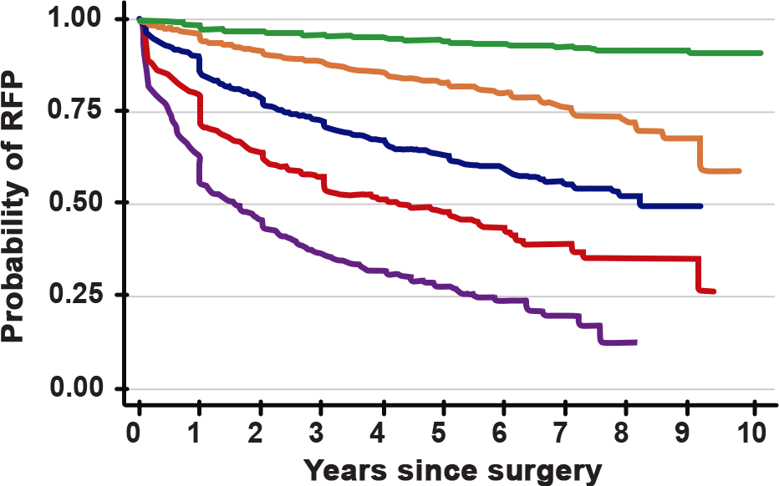
Modified Gleason Scoring System Predictive of Localised Disease Outcome
5/10
RFP following radical prostatectomy stratified by (A) prostatectomy grade and (B) pre-prostatectomy biopsy grade¹
A
B
(Green line: Gleason score ≤6, grade group 1; Orange line: Gleason score 3 + 4, grade group 2; Dark blue line: Gleason score 4 + 3, grade group 3; Red line: Gleason score 8, grade group 4; Purple line: Gleason score ≥9, grade group 5)
RFP, recurrence-free progression.
Adapted from Epstein, 2016¹
This study demonstrated that the hazard ratios for Gleason score (4 + 3) were generally 3-fold higher than those for (3 + 4), while those for (9-10) were about twice as high as those for 8.¹
Epstein JI, et al. Eur Urol. 2016;69:428-435.
Notes:
Modified Gleason scoring system predictive of localised disease outcome
In this study conducted from 2005 to 2014, 20,845 consecutive men with clinically localised prostate cancer were treated by radical prostatectomy (RP) at various institutions in the US and Sweden. The graphs compare the recurrence-free progression (RFP) following RP, with graph A stratified by prostatectomy grade and graph B stratified by pre-prostatectomy biopsy grade. This study found that the hazard ratios for Gleason score (4 + 3) were generally 3-fold higher than those for (3 + 4), while those for (9-10) were about twice as high as those for 8. The 5-year biochemical recurrence-free progression probabilities for RP Gleason scores 6, (3 + 4), (4 + 3), 8 and 9-10 were 96% [95% confidence interval (CI), 95-96], 88% [95% CI, 85-89], 63% [95% CI, 61-65], 48% [95% CI, 44-52] and 26% [95% CI, 23-30], respectively.¹ /p430/col1/para3, /p432/Fig1-2
This study is one of many other studies that have shown the modified Gleason scoring system to correlate well with patient prognosis.
Reference:
Epstein JI, Zelefsky MJ, Sjoberg DD. et al. A contemporary prostate cancer grading system: a validated alternative to the Gleason score. Eur Urol. 2016;69:428-435. doi:10.1016/j.eururo.2015.06.046.

Slide 47
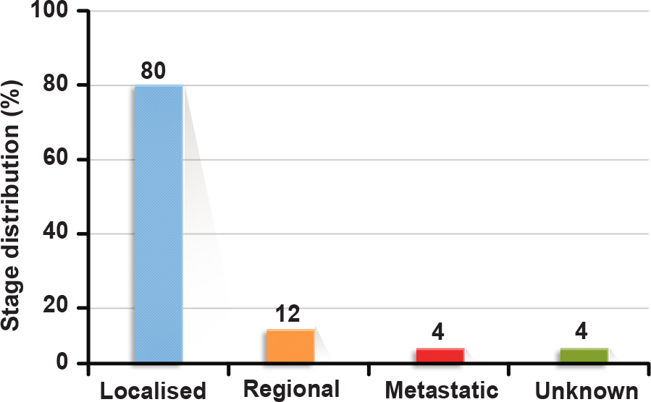
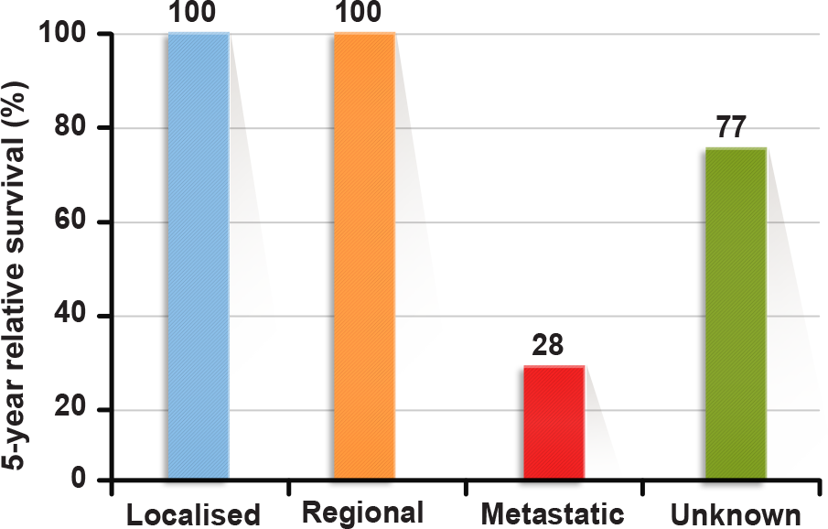
Prognosis in Prostate Cancer: Localised Versus Metastatic Disease
6/10
Based on US surveillance, epidemiology, and end results (SEER) statistics (by National Cancer Institute), prostate cancer is a highly curable disease if diagnosed at an early stage¹⁻³
Stage distribution at diagnosis from
2005-2011, all races²
5-year relative survivalª with respect to stage 2005-2011, all races²
ªSurvival of cancer patients in comparison with the general population
Adapted from SEER Cancer Statistics Review, 2016²
http://www.cancer.org/acs/groups/content/@editorial/documents/document/acspc-044552.pdf. Accessed April 6, 2016.
http://seer.cancer.gov/csr/1975_2012/results_merged/topic_survival.pdf. Accessed April 5, 2016.
Scher HI, et al. Harrison’s Principles of Internal Medicine. Vol. 1. 19th ed. New York, NY: McGraw-Hill Education; 2015:579-587.
Notes:
Prognosis in prostate cancer: Localised versus metastatic disease
According to a recent report published by the surveillance, epidemiology, and end results (SEER) programme of the National Cancer Institute, the 5-year survival rate in all patients irrespective of age and ethnicity was found to be 100% in case of localised and regional prostate cancer and 28% in case of distant metastasised prostate cancer.¹⁻³ /p19/Table, /p1/Table23.8, /p580/col1/para3
Most patients have localised or regional disease at diagnosis. However, a subgroup of prostate cancer patients develop incurable metastatic disease. In these patients androgen deprivation therapies (ADT) typically result in rapid responses.⁴ /p40/col1/para1
Let us pause for a moment here to reflect on what we have learnt so far.
References:
Cancer facts and figures 2015. American Cancer Society Web site. http://www.cancer.org/acs/groups/content/@editorial/documents/document/acspc-044552.pdf. Accessed April 6, 2016.
SEER Cancer Statistics Review 1975-2012. National Cancer Institute Web site. http://seer.cancer.gov/csr/1975_2012/results_merged/topic_survival.pdf. Accessed April 5, 2016.
Scher HI, Eastham JA. Benign and malignant diseases of the prostate. In: Kasper DL, Fauci AS, Hauser SL, Longo DL, Jameson JL, Loscalzo J, eds. Harrison’s Principles of Internal Medicine. Vol. 1. 19th ed. New York, NY: McGraw-Hill Education; 2015:579-587.
Vishnu P, Tan WW. Update on options for treatment of metastatic castration-resistant prostate cancer. Onco Targets Ther. 2010;3:39-51. doi:10.2147/OTT.S5818.

Slide 48
Risk Stratification by D’Amico Classification
7/10
EAU risk groups for biochemical recurrence of localised and locally
advanced prostate cancer¹
Low risk
Intermediate risk
High risk
Definition
PSA < 10 ng/mL
PSA 10-20 ng/mL
PSA > 20 ng/mL
Any PSA
GS < 7
GS 7
GS > 7
Any GS
cT1-2a
cT2b
cT2c
cT3-4 or cN+
Localised
Locally advanced
GS, Gleason score; PSA, prostate-specific antigen.
Adapted from Mottet, 2016¹
Stratification based on¹:
1. Serum PSA value
2. Biopsy score (Gleason scores)
3. Clinical stage
https://uroweb.org/guideline/prostate-cancer/#4. Accessed April 7, 2016.
Notes:
Risk stratification by D’Amico classification
The EAU classifies prostate cancer based on D’Amico’s classification system as well.¹ /p6/Table4.2.2 This classification is done by grouping patients with a similar risk of biochemical recurrence after surgery or radiation.¹ /p2/para1, /p3/para1
Reference:
Mottet N, Bellmunt J, Briers E. et al. EAU Prostate Cancer guidelines. European Association of Urology Web site. https://uroweb.org/guideline/prostate-cancer/#4. Accessed April 7, 2016.

Slide 49
Knowledge Check (12)
8/10
In case of high-risk localised or locally advanced prostate cancer, the EAU guidelines suggest the following tests for staging:
CT/MRI
mpMRI
PET scan
Bone imaging
CT/MRI
mpMRI
Bone Imaging
CT, computed tomography; mpMRI, multiparametric magnetic resonance imaging; PET, positron emission tomography.
Notes:
Knowledge check (12)
In case of high-risk localised or locally advanced prostate cancer, the EAU guidelines suggest the following tests for staging:
CT/MRI
mpMRI
PET scan
Bone imaging
Answer: 1, 2 and 4. CT/MRI, mpMRI and bone imaging may be used for staging of high-risk localised or locally advanced prostate cancer.
CT, computed tomography; mpMRI, multiparametric magnetic resonance imaging; PET, positron emission tomography.

Slide 50
Knowledge Check (13)
9/10
Arrange the Gleason scores according to their prognostic chances (from least favourable outcome to most favourable outcome) using the latest ISUP guidelines:
1. Gleason score 8 (4 + 4)
1. Gleason score 7 (3 + 4)
2. Gleason score 6 (4 + 2)
3. Gleason score 7 (4 + 3)
4. Gleason score 8 (4 + 4)
2. Gleason score 7 (4 + 3)
3. Gleason score 7 (3 + 4)
4. Gleason score 6 (4 + 2)
ISUP, International Society of Urological Pathology.
Notes:
Knowledge check (13)
Arrange the Gleason scores according to their prognostic chances (from least favourable outcome to most favourable outcome) using the latest ISUP guidelines:
Gleason score 7 (3 + 4)
Gleason score 6 (4 + 2)
Gleason score 7 (4 + 3)
Gleason score 8 (4 + 4)
Answer: 4, 3, 1 and 2. The answer is based on the 2014 ISUP update for the Gleason scoring system. The correct answer is:
Gleason score 8 (4 + 4) – Grade 4
Gleason score 7 (4 + 3) – Grade 3
Gleason score 7 (3 + 4) – Grade 2
Gleason score 6 (4 + 2) – Grade 1
ISUP, International Society of Urological Pathology.

Slide 51
Knowledge Check (14)
10/10
John has been diagnosed with prostate cancer with the following test results:
Test
Result
PSA level
12 ng/mL
Gleason grade
7
Clinical stage
T2b
Based on D’Amico’s classification of risk assessment, identify the recurrence risk of prostate cancer in John’s case.
Low risk
Intermediate risk
High risk
Intermediate risk
PSA, prostate-specific antigen.
Notes:
Knowledge check (14)
John has been diagnosed with prostate cancer with the following test results:
Test Result
PSA level 12 ng/mL
Gleason grade 7
Clinical stage T2b
Based on D’Amico’s classification of risk assessment, identify the recurrence risk of prostate cancer in John’s case.
Low risk
Intermediate risk
High risk
Answer: 2. Patients who have PSA levels between 10 and 20 ng/mL, a Gleason score of 7 or are in clinical stage T2b have an intermediate risk of recurrence.
PSA, prostate-specific antigen.

Slide 52
Summary

Slide 53

Summary
1/2
Anatomy and physiology of prostate gland
Most prostate cancers develop in the peripheral zone of the prostate.
Androgens regulate the proliferation and death of cells in a normal prostate.
Types of prostate cancer
The most common type of prostate cancer is adenocarcinoma.
Age, ethnicity/race and heredity are the only 3 established risk factors for prostate cancer.
Early prostate cancer typically has no symptoms, but the severity of symptoms increases with the spread of prostate cancer.
Epidemiology of prostate cancer
Prostate cancer is one of the most common cancers in men and is the second leading cause of death in men, worldwide.
An increasing trend of prostate cancer incidence and mortality is observed in South Korea.
Notes:
Summary
Anatomy and physiology of prostate gland
Most prostate cancers develop in the peripheral zone of the prostate.
Androgens regulate the proliferation and death of cells in a normal prostate.
Types of prostate cancer
The most common type of prostate cancer is adenocarcinoma.
Age, ethnicity/race and heredity are the only 3 established risk factors for prostate cancer.
Early prostate cancer typically has no symptoms, but the severity of symptoms increases with the spread of prostate cancer.
Epidemiology of prostate cancer
Prostate cancer is one of the most common cancers in men and is the second leading cause of death in men, worldwide.
An increasing trend of prostate cancer incidence and mortality is observed in South Korea.

Slide 54
Summary (cont.)
2/2
Diagnosis and screening guidelines for prostate cancer
Screening for prostate cancer is a controversial topic and guidelines vary.
Pros of PSA screening include early detection of prostate cancer, as advanced disease is harder to treat.
Cons of PSA testing include over-diagnosis and over-treatment of patients and no benefits for survival rates.
Prostate cancer can only be definitively diagnosed by the presence of adenocarcinoma in prostate biopsy cores or operative specimens.
The decision to perform a biopsy is based on PSA levels or a suspect DRE.
Staging and classification of prostate cancer
The Gleason score is used for grading biopsy core samples and can also be correlated as a predictor for prostate cancer-related deaths.
The TNM classification system is used to stage the cancer to determine the right course of treatment.
Based on TNM classification, prostate cancer can be differentiated into 4 stages.
Notes:
Summary (cont.)
Diagnosis and screening guidelines for prostate cancer
Screening for prostate cancer is a controversial topic and guidelines vary.
Pros of PSA screening include early detection of prostate cancer, as advanced disease is harder to treat.
Cons of PSA testing include over-diagnosis and over-treatment of patients and no benefits for survival rates.
Prostate cancer can only be definitively diagnosed by the presence of adenocarcinoma in prostate biopsy cores or operative specimens.
The decision to perform a biopsy is based on PSA levels or a suspect DRE.
Staging and classification of prostate cancer
The Gleason score is used for grading biopsy core samples and can also be correlated as a predictor for prostate cancer-related deaths.
The TNM classification system is used to stage the cancer to determine the right course of treatment.
Based on TNM classification, prostate cancer can be differentiated into 4 stages.
In this section, you learnt the following: Hormone regulation mechanism, the types of hormones and their physiological action, the risk factors associated with prostate cancer, the increasing trend of prostate cancer incidence and mortality in South Korea, staging and screening guidelines, and the diagnosis and evaluation test interpretations for prostate cancer. It is important to remember that PSA alone is not enough as a diagnosis tool for prostate cancer and that increased surveillance of prostate cancer leads to overtreatment of the disease.

Slide 55

Thanks for your attention.
Implement the learnings from this section in your scientific interactions with HCPs.

